Slide 1
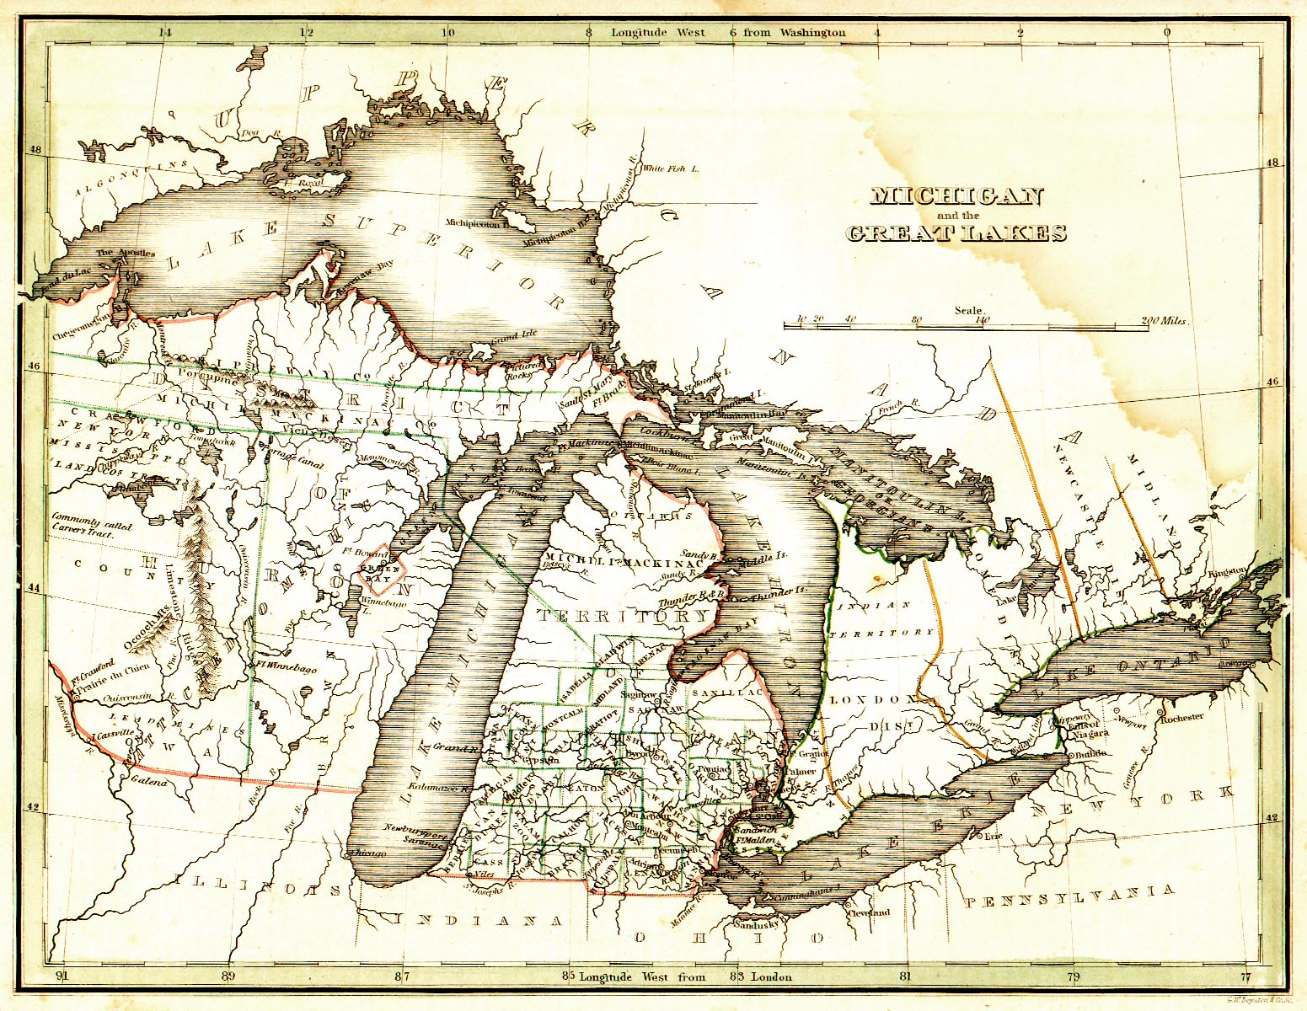
1820-1860
The Birth of Industry and the State of Michigan
http://usgwarchives.org/maps/michigan/statemap/mich-1.jpg

Slide 2
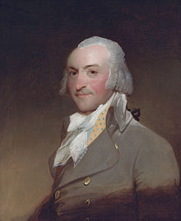
The Final Era of the Fur Trade
1815-1850
http://en.wikipedia.org/wiki/Fort_Kiowa
John Jacob Astor and the American Fur Company (AFC) dominated postwar fur trade, even against the rival British North West Company.
1822 – Congress ended government “factories,” and Astor squeezed independent traders by selling goods to Indians at very low prices in exchange for furs.
Gov. Lewis Cass was a friend and assisted him to maintain monopoly. AFC controlled 95% of fur trade.
By mid-1830s, fur trading center was St. Louis, not Mackinac, and Astor sold the AFC. Silk hats replaced fur hats in the 1840s.
The AFC went out of business in 1842, and split into several companies that went out of business in the 1850s.
The Astor family
invested in real estate after the end of the fur trade.

Slide 3
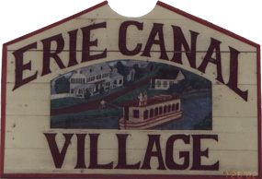
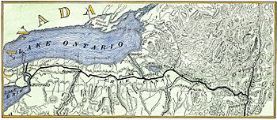
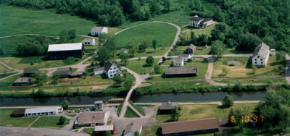
The Erie Canal opens (1825)
- The canal links Lake Erie to the Hudson River in the east. 363 miles from Albany, NY to Buffalo, NY. Now called the New York State Canal System.
It cost $7 million to build, and paid for itself in 3 years
It included 18 aqueducts to carry the canal over ravines and rivers, and 83 locks, with a rise of 568 feet.
Cut transport costs by 95%
http://www.answers.com/topic/erie-canal
http://www.eriecanalvillage.net/
Erie Canal Village in Rome, NY is an outdoor living history museum reconstructed to 1817

Slide 4
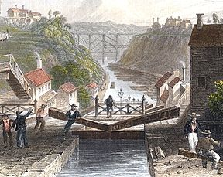
Impact of the Erie Canal on Michigan
Did not cause an immediate rush to Michigan, but facilitated movement
Brought many settlers from Western New York to Michigan (Troy, Rochester, Utica, New Buffalo)
http://en.wikipedia.org/wiki/Erie_Canal

Slide 5
Erie Canal Song
(Low Bridge, Everybody Down)
I've got a mule, and her name is Sal,
Fif-teen miles on the Er-ie canal,
She's a good ol' worker and a good ol' pal,
Fifteen miles on the Er-ie can-al,
We've hauled some barges in our day,
Filled with lum-ber coal and hay,
And we know ev'ry inch of the way
From Al-ba-ny to Buff-a-lo OH
Chorus
Low bridge ev'-ry bod-y down,
Low bridge for we're com-in to a town,
And you al-ways know your neighbor,
You'll always know your pal,
If you've ev-er navigated on the Er-ie can-al

Slide 6
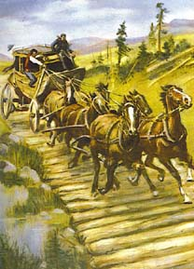

“Corduroy” Roads
1827 – Detroit to Toledo road completed at federal cost of $32,000
1827 – Congress approves funds for “Chicago Road” on parts of Old Sauk Trail (now U.S.-12) to link Fort Dearborn in Chicago to Detroit
1829 – Congress approves funds for “Territorial Road” from Ypsilanti to St. Joseph (now I-94)
1829 – Congress approves funds for road from Detroit to Fort Gratiot (now Port Huron)
1829 – Congress approves funds for road from Detroit to Saginaw
Although winding and very rugged, roads provided traveler with a route along which taverns and towns sprung up
http://thishouse.ca/63wales_maps_mls.htm
http://iarchives.nysed.gov/dmsBlue/viewImageData.jsp?id=80322

Slide 7
Factors slowing Michigan Growth
Sandy soils where pine trees grow vs. rich soil of the plains in Illinois
Railroad construction slow due to lakes on both sides of the Lower Peninsula
Lumbering didn’t become important until after 1860

Slide 8
1830’s – “Michigan Fever”
1830 – 147,062 acres sold
1834 – 498,423 acres sold
1836 – 4,189,248 acres sold (mostly in western Michigan)
Speculators bought most of land for $1.25 per acre, and sold it to settlers for at least $2.50/acre
Need 60,000 adults to become a state

Slide 9
Population Boom in michigan AND DETROIT
1820 – 8,765 (1,422 in Detroit)
1830 – 31,639 (2,222 in Detroit)
1840 – 212,267 (9,192 in Detroit) (1830’s = largest population growth of any decade in state history = 7x increase) (Detroit had 4x increase)
1850 – 397,654 (21,019 in Detroit)
1860 – 749,113 (45,619 in Detroit)
Most people arrive in Detroit by water, then took wagon into interior

Slide 10
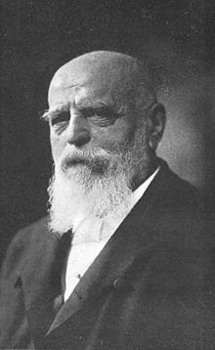
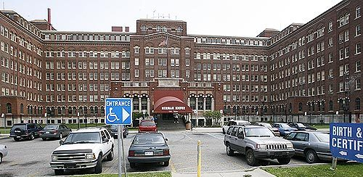
German Immigrants
http://en.wikipedia.org/wiki/Herman_Kiefer
First wave to Detroit started in 1825.
Catholics (Lutherans) who spoke German
Hard workers, but tended to be Socialists, who preferred strikes
1845 – established Frankenmuth (15 colonists bought 680 acres for $1,700)
1847 – Frankentrost (22 families settled 6 miles north of Frankenmuth)
1848 – Frankenlust (22 miles north of Frankenmuth)
1850 – Frankenhilf (called Richville today)
Most famous was Dr. Herman Kiefer, who emigrated from Germany in 1849. Member of Detroit Board of Education, and a regent at U of M.
Most went to Wisconsin, searching for cheap land
Herman Keifer Health Complex houses the Department of Vital Records. It was once a hospital for polio, TB, diphtheria, and other diseases before these patients were allowed in other hospitals.
http://voiceofdetroit.net/2013/04/18/detroit-city-council-says-yes-to-banks-in-jones-day-vote-people-say-no/herman-kiefer-health-complex-3/

Slide 11
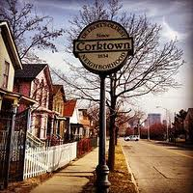
Irish Immigrants
http://en.wikipedia.org/wiki/Corktown,_Detroit
Start arriving in Detroit in 1830.
Fled the Irish Potato Famine 1845-1852
Catholic, not Protestant like most residents
Accent and poverty made them stick out
Moved to cities, working as railroad laborers or domestic servants or opened their own businesses.
Anti-English, so aided the Canadians in 1837-1842 Patriot’s War
Corktown is the
oldest neighborhood
in Detroit

Slide 12
Counties
38 counties by 1837 (Only 1 county in 1796)
Wayne County (23,400 = 13% of state) Detroit had 9,000 (38% of Wayne Co.). In 1827, Wayne County was divided into 9 townships.
Washtenaw Co. (21,817) – Chippewa word for “grand river” = Huron River
Oakland Co. (20,176) – named for oak openings
Lenawee Co. (14,540) – Shawnee word for “Indian”

Slide 13
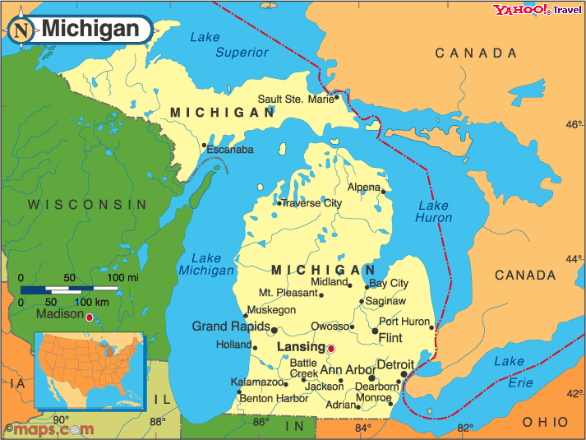
10 Largest towns in 1837
Detroit (city)
Ann Arbor
Monroe
Tecumseh
Ypsilanti
Adrian
Marshall
Pontiac
Grand Rapids
Niles
http://www.netstate.com/states/geography/mapcom/mi_mapscom.htm

Slide 14
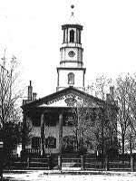
TERRITORIAL government
In 1823, Congress transferred governance of the Territory of Michigan to the governor (appointed by the President) and legislative council comprised of 9 members. No house of representatives or “general assembly” was set up as required by NW Ordinance.
Had non-voting delegate in Congress until became a state
Voting restricted to men who owned at least 50 acres of land, and had lived in area for at least 2 years
1823-28 - Territorial capitol building was built on Griswold Street. After the capital of Michigan moved to Lansing, the former capitol was a public high school until 1893, when it burned down. The land is now called Capitol Park, a historic district bounded by Griswold, Shelby, and State streets.
The Capitol, circa 1847
http://www.hal.state.mi.us/mhc/timetraveler/statehood/todo.html

Slide 15
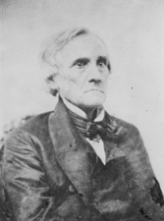
Early Congressional representatives
http://en.wikipedia.org/wiki/William_Woodbridge
William Woodbridge
Solomon Sibley
Col. John Biddle (brother of Nicholas Biddle, president of the Second Bank of the United States)
Gabriel Richard (only Catholic priest in Congress until 1970). Richard died in 1832 from cholera outbreak in Detroit.
Woodbridge was the secretary of the territory from 1818-1830. He later became a U.S. Senator after 1837. He became governor in 1840, but left office for the US Senate.

Slide 16
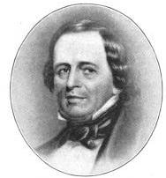
John R. Williams
First elected mayor of Detroit in 1825. He was elected mayor five times: in 1824, 1830, and 1844, 1845, and 1846. Before he died, he named “John R” road in his honor. He wrote the City Charter in 1824.
He and his uncle Joseph Campau founded the Detroit Free Press in 1831.
Was a delegate at the first Michigan Constitutional Convention in 1835.
One of the first trustees of U of M.
President of the Detroit Board of Education
Williams served in the War of 1812, and as a brigadier general in the Black Hawk War of 1832.
http://en.wikipedia.org/wiki/List_of_mayors_of_Detroit

Slide 17
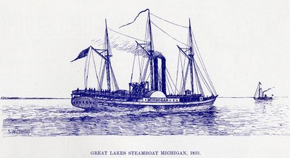
Ship-building
1827 – Oliver Newberry starts ship-building industry in Detroit with the Argo in 1927. The largest steamer was the Michigan built in 1833 (below).
Built docks, warehouses, stores, offices, and a ship building yard along Detroit’s waterfront
By 1850, shipping was Detroit’s biggest industry.
Newberry’s nephew, John S. Newberry, would later greatly expand the shipping industry in Detroit
http://www.maritimehistoryofthegreatlakes.ca/documents/hgl/default.asp?ID=c023

Slide 18
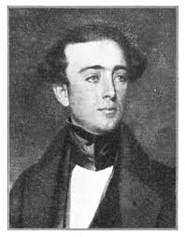
Stevens T. Mason (the Boy Governor)
Replaced Gov. Lewis Cass in 1831 (19 years old) as temporary acting governor when Cass became Andrew Jackson’s Secretary of War
Jackson appointed George B. Porter (1831-1834) as new governor, but he was frequently absent over next three years, so Mason filled in. In 1834, Porter got cholera, and Mason officially took power.
In Nov. 1834, Jackson appointed Henry Gilpin to be governor, but the U.S. Senate rejected him, and then Jackson tried to appoint Charles Shaler, but Shaler declined. Jackson appointed John Horner, but he was ignored by Michigan officials, who liked Mason.
Punched an editor once for calling him the “Boy Governor”
http://www.gutenberg.org/files/21532/21532-h/21532-h.htm

Slide 19
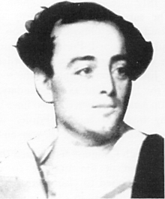
Mason pushes statehood
http://en.wikipedia.org/wiki/Stevens_T._Mason
Population doubled from 1830 to 1833, so had over 60,000 residents necessary for statehood.
Enabling Act = Congress grants territories the power to become a state with own legislature, laws, and taxes.
1834 – Acting Gov. Mason calls for a census, and asks Territorial Council to call a constitutional convention, elect a representative and two senators, and demand admission to the Union (Tennessee did the same in 1796). Census showed 92,000.

Slide 20
Constitutional Convention
May 11, 1835 – 91 elected delegates (half were farmers, only 10 were lawyers) meet in Detroit for constitutional convention. In only 45 days, they had a constitution.
Created a “bill of rights,” and bicameral legislation with house (48-100 members elected annually) and senate with 1/3 as many members elected biannually

Slide 21
Michigan Constitution of 1835
Tried to restrict to landowners, but agreed to everyone over 21 with 6 months’ residency.
State Superintendent of Public Instruction (first state to establish this position, which could not be abolished for any reason)
Funds from land sales MUST be used for schools, and put in perpetual primary school fund (interest used for schools)
Section 16 lands varied greatly

Slide 22
Michigan Constitution of 1835
Internal improvements: roads, railroads, canals
Governor, Lieutenant Gov., and legislators are elected, not appointed (elections held in odd-number years to avoid national elections)
Praised for its simplicity
Michigan rewrote entire Constitution several times: 1850, 1908, 1963. These limited the power of government as scandals arose, and the public lost faith in their elected officials.

Slide 23
12 Differences between Constitutions
Michigan Constitution of 1835
U.S. Constitution of 1787
White males over 21
No min. age to be legislator
Either house can start bill
Governor has 2 year term
Gov must be U.S. citizen 5 years
State Reps have 1 year term
S.C. Justices have 7 year term
Seat of Gov’t TBD in 10 years
Amendments with 2/3 of both houses, then majority of people
No slavery allowed
Mentions “Almighty God”
Legislative powers left vague
Doesn’t define voter
25 to be Rep, 30 to be Sen.
Bills start in House of Reps
President has 4 year term
Pres must be U.S. citizen 14 years
State Reps have 2 year term
S.C. Justices have life term
N/A
Amendments with 2/3 of both houses, then ¾ of states
No mention of slavery
No mention of God
Legislative powers spelled out

Slide 24
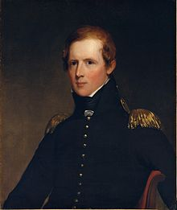

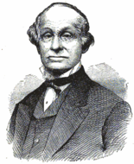
Nov. 1, 1835 – Government begins
http://en.wikipedia.org/wiki/John_Biddle_(Michigan_politician)
Stevens T. Mason (Democrat) vs. John Biddle (Whigs) of the land office in Detroit for Governor.
Andrew Jackson replaced Mason with John Horner (“Little Jack”), who was ignored for 9 months from Sept. 1835 – July 1836
http://www.gutenberg.org/files/21532/21532-h/21532-h.htm
Horner was not in favor of statehood for Michigan. He released Ohioans who were jailed for trespassing during Toledo Strip Dispute. He was only in “power” for 9 months.
http://en.wikipedia.org/wiki/John_S._Horner

Slide 25
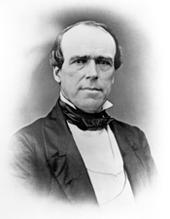
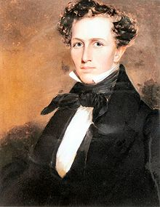
New Government
Constitution adopted with 83% of vote, and Mason won with 90% of vote
Legislature selected two U.S. senators: Lucius Lyon and John Norvell. Until statehood in 1837, they were “spectators” who couldn’t talk or vote
In March 1836, created a state supreme court and judicial system
John Norvell was a U.S. Senator from 1835 to 1841.
Lucius Lyon was a U.S. Senator from 1835 to 1839
http://en.wikipedia.org/wiki/John_Norvell
http://en.wikipedia.org/wiki/Lucius_Lyon

Slide 26
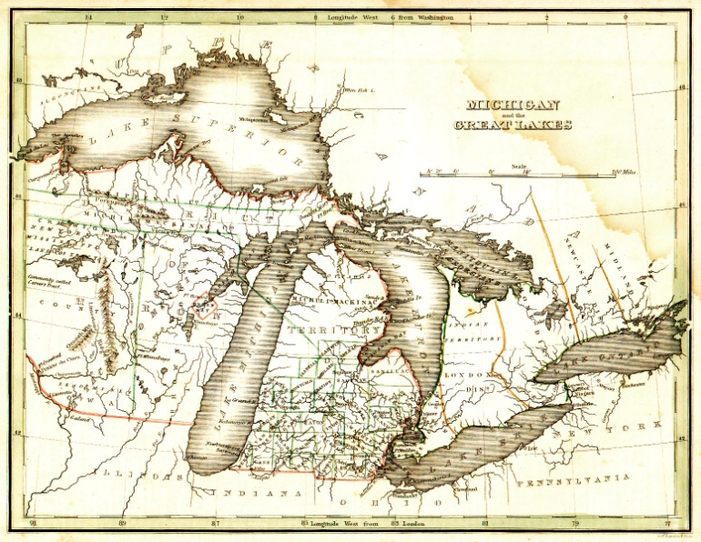
Border disputes
http://usgwarchives.org/maps/michigan/statemap/mich-1.jpg
Northwest Ordinance of 1787 made Michigan’s southern boundary run east-west from tip of Lake Michigan
Indiana became state in 1816, and asked Congress to push border 10 miles north so as to have some access to Lake Michigan (Michigan City, Elkhart, and South Bend became part of Indiana)
Illinois became state in 1818, and asked Congress to push border with Wisconsin 60 miles north of tip of Lake Michigan

Slide 27
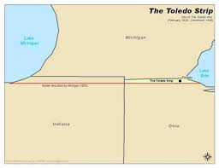
The Toledo War (a.k.a. The Toledo Dispute)
Dispute was about whether the Maumee River (and Toledo) should be in Michigan or Ohio. Confusion was based on where the southern end of Lake Michigan was, and Michigan’s southern boundary line drawn straight eastward from it.
Ohio put in their 1803 constitution that they would have the Maumee River, but Congress never officially agreed to this, even though Ohio was allowed to become a state.
http://mentalfloss.com/article/22671/3-american-border-disputes-you-probably-never-studied

Slide 28
Tiffin vs. Cass (again)
Edward Tiffin, former Ohio governor, as Surveyor General of the Northwest Territory, hired William Harris to survey the boundary in 1817 but put the Maumee River in Ohio (called “The Harris Line”)
Gov. Lewis Cass protested, and hired John Fulton to survey in 1818 (called “The Fulton Line”)
“Toledo Strip” was 8 miles wide in the east and 5 miles wide in the west, and had 470 sq. miles.

Slide 29
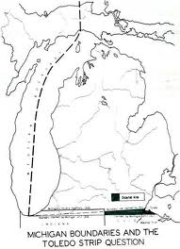
Michigan only had 25% of the Upper Peninsula. The rest was still part of the Northwest Territory.
Border claimed by Ohio (the Harris Line)
Border claimed by Michigan and in Northwest Ordinance (the Fulton Line)

Slide 30
The Toledo Strip
From 1818-1833, Michigan had jurisdiction of the area, and a land company bought land at the mouth of the Maumee and laid out two towns united into Toledo in 1833 under jurisdiction of Monroe County, Michigan.
Conflict arose again when Michigan applied for statehood in late 1833, so another survey was ordered (Talcott line was basically the same as the Fulton line).

Slide 31
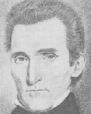
Mason vs. Lucas
http://www.gutenberg.org/files/21532/21532-h/21532-h.htm
http://en.wikipedia.org/wiki/Robert_Lucas_(governor)
Senate sided with Ohio, House of Reps sided with Michigan
Michigan Territorial Council (MTC) calls for negotiations, but Gov. Robert Lucas of Ohio (testified vs. Gov. Hull) rejects and names area Lucas County.
MTC imposes fine on anyone trying to assert authority over Toledo Strip, but Gov. Lucas appoints sheriff and judges
“Pains and Penalties Act” = $1,000 fine and/or 5 years hard labor to any Ohio resident who trespasses.
Gov. Mason mobilizes the territorial militia, so Pres. Jackson ask for opinion of his attorney general, who sides with Michigan

Slide 32
The Toledo War heats up
Pres. Jackson favored Ohio to gain votes so sent two commissioners to resolve.
April 26, 1836 – Battle of Phillips Corners - Mason wouldn’t back down, so the Michigan militia arrests nine surveyors from Ohio on property owned by Col. Eli Phillips.
Ohioans called the Michiganders “wolverines” for their nasty temperament
No one was killed, but a sheriff’s deputy was stabbed by a pen while trying to arrest someone

Slide 33
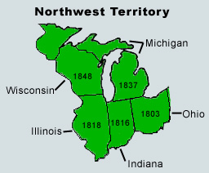
The U.P. is separated from Wisconsin
April 1836 – Territory of Wisconsin was created without the U.P., because some thought it would be too big
Congress tells Michigan it must surrender the Toledo Strip in return for the U.P.
http://www.sd4history.com/unit1/nwterritory.htm

Slide 34
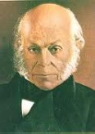
Special Convention – Sept. 1836
Should Michigan accept terms?
J.Q. Adams “Never in the course of my life have I known a controversy of which all the right was so clearly on one side and all the power so overwhelmingly on the other.”
John Quincy Adams, President from 1825-1829, was the first president to be photographed in 1843. He served as a Representative for 17 years until his death.
http://law2.umkc.edu/faculty/projects/ftrials/amistad/ami_bada.htm

Slide 35
Opposition to the U.P.
“sterile region on the shores of Lake Superior, destined by soil and climate to remain forever a wilderness.” -
“A region of perpetual snows” - Detroit Free Press
Yoopers did not want to become part of Michigan either. Wanted to be organized as the Huron Territory.
49 delegates met in Ann Arbor (Convention of Assent), and rejected Congress’ offer.

Slide 36
Arguments for accepting statehood
Ohio was in control of Toledo Strip
MI would receive 5% of proceeds from sale of public lands in Michigan during 1836 (about $250,000)
MI would receive about $400,000 as share of federal government’s surplus if admitted by 1/1/1837.
Gov. Mason led fight for accepting Congress’ offer, and called for a second Convention of Assent in Ann Arbor on Dec. 14, 1836 (Frostbitten Convention) which overwhelmingly approved.
Pres. Jackson signed bill making Michigan the 26th state on January 26, 1837. Arkansas gained admission as a slave state on 6/15/1836.

Slide 37
Who got the best deal?
Michigan-Ohio border wasn’t satisfactorily surveyed and marked until 1915, and water boundary in Lake Erie not resolved until 1973.
The Upper Peninsula contains 29% of Michigan land area, but only 3% of population. Copper, iron, and timber far exceeds value of Toledo. Michigan received over 9,000 sq. miles in exchange for 470 sq. miles.
Michigan unsuccessfully filed suit in 1966 in a federal court to reclaim Toledo.
Copper, iron, and timber provided raw materials to fuel the industrial growth and material wealth of Detroit in the 19th century to transform it into the Motor City in the 20th century

Slide 38
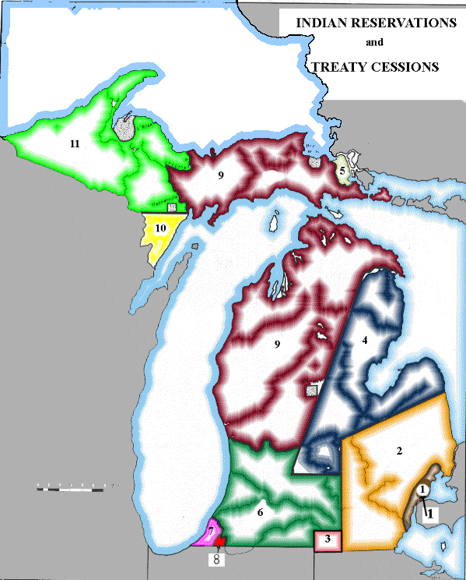
Hunting and Fishing Rights in the Treaty of Washington (1836) and La Pointe (1842, 1854)
Indians retained the right to hunt, fish, and gather in the ceded land = usufructory rights. Reservations were established.
Treaty of Washington = area in RED, about 13 million acres (37% of MI). Indian agent Henry Schoolcraft helped negotiate. Some Indians who signed it were later killed by other Indians.
Treaty of La Pointe = area in LIGHT GREEN. Fort Wilkins in Copper Harbor was built to protect against disgruntled Indians.
1979 - Federal District Judge Noel Fox agreed that Indians are exempt from state regulations for fishing. In 1985, the Tribal Fishing Agreement established zones for non-Indian fishing and Indian fishing.
https://www.cmich.edu/library/clarke/ResearchResources/Native_American_Material/Treaty_Rights/Text_of_Michigan_Related_Treaties/Pages/Map-of-Treaty-Cessions.aspx

Slide 39
2011 MDNR Notice
“The Department of Natural Resources reminds the public that certain fishing opportunities for tribal members of tribal governments located within the 1836 Treaty of Washington and 1842 Treaty of La Pointe are different than those allowed for state-licensed recreational anglers under Michigan law, and that these activities may be observed this spring.”
“As established under the 2007 Inland Consent Decree, Tribal members may use spears or conventional fishing tackle to take walleye and steelhead in some waters of Michigan covered by the 1836 treaty. Similarly, a tribally-regulated, spring subsistence spear fishery is present in the western portion of the Upper Peninsula within the 1842 Treaty area. These activities may occur during periods when these waters are closed to fishing for State-licensed recreational anglers.”

Slide 40
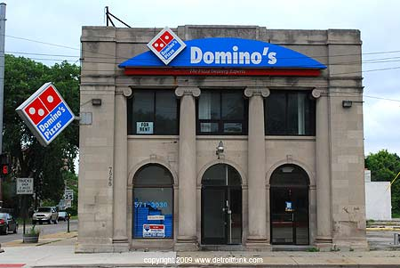
The Role of Banks
Land boom from 1830-1836 thanks to easy credit. State banks sprung up in place of conservative Bank of the United States, and issues inflationary paper money that wasn’t backed by enough gold.
General Banking Law of 1837 (first in U.S.) – 12 Michigan landowners with at least $50,000 could form a banking association.
49 banks were organized, but many were “wildcat banks” that lied to inspectors about the amount of specie (gold and silver coins) on hand. They issued bank notes promising to pay on demand, but could not pay people in gold and silver
The Detroit Savings Fund Institute, founded in 1849, is the forerunner of Comerica Bank today. The original building is once a church, and now it’s a Domino’s Pizza store.
https://www.google.com/search?q=detroit+savings+fund+institute&espv=210&es_sm=93&source=lnms&tbm=isch&sa=X&ei=yXwWU6fRE-fw0gG3v4C4DA&ved=0CAsQ_AUoAw&biw=1307&bih=596#facrc=_&imgrc=r4-O2eLTVD6WuM%253A%3BwWMcTh_5a2aosM%3Bhttp%253A%252F%252Fwww.onlinebankingservices.org%252Fwp-content%252Fuploads%252F2013%252F05%252FDetroit-Saving-Fund-Institute.jpg%3Bhttp%253A%252F%252Fwww.onlinebankingservices.org%252Fcomerica%252Fcomerica-bank-review-history-services-and-financial-situation%252F%3B450%3B251

Slide 41
Speculation and Transportation Boom
People rushed to Michigan in 1836 to buy land cheap and sell for much more.
Transportation advances fueled growth of Michigan
1825 – Erie Canal opens
1827 – B & O Railroad opens
1828 – Chesapeake and Ohio canal construction starts
1838 - Detroit and Pontiac Railway reaches Royal Oak (12 miles) in 1838, then reached Pontiac (13 miles) in 1844.
1833 – Erie and Kalamazoo Railroad – most successful railroad in Michigan. Used wooden rails and pulled by horses until 1837, when used a steam locomotive.

Slide 42
Railroads
Railroad building lagged behind neighboring states (only 475 miles built in Michigan in the 1850s vs. 2,325 in Ohio and 2,757 in Illinois).
John W. Brooks organized a group to buy the Michigan Central Railroad.
At 18 mph, trains could go from Detroit to Chicago in 1 ½ days.
The “Great Railroad Conspiracy” = trains killed livestock, but railroad owner offered to pay only half of value. Enraged farmers vandalized and burned railroad property. They went to prison, which reduced the violence.

Slide 43
Railroads
Michigan Central paid $500,000 to share tracks with the Illinois Central to reach Chicago in 1852. Two years later, Detroit was connected to New York City.
Few railroad tracks laid north of Flint, so Congress in 1856 offered large grants of land to railroads for every mile of track laid
Plank road building in 1850s started to reduce demand for railroads

Slide 44
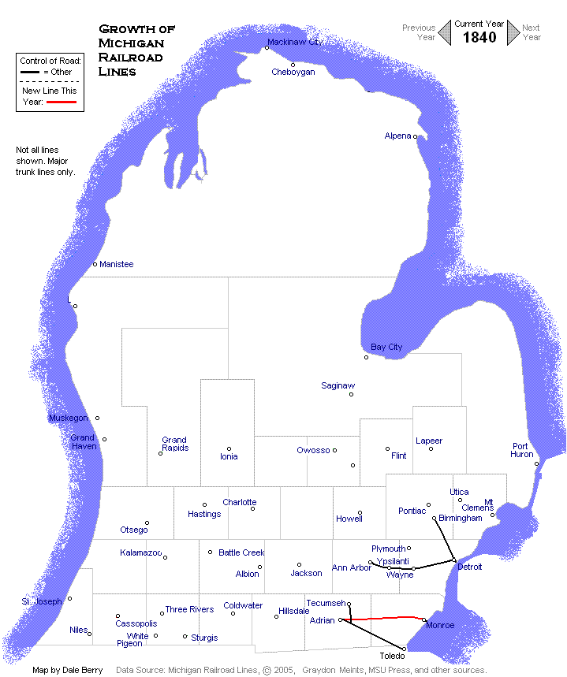
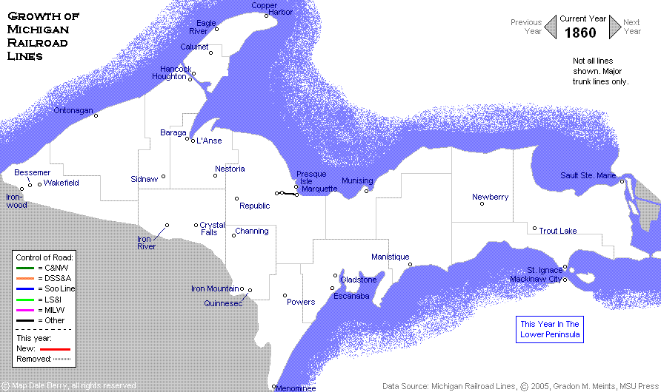
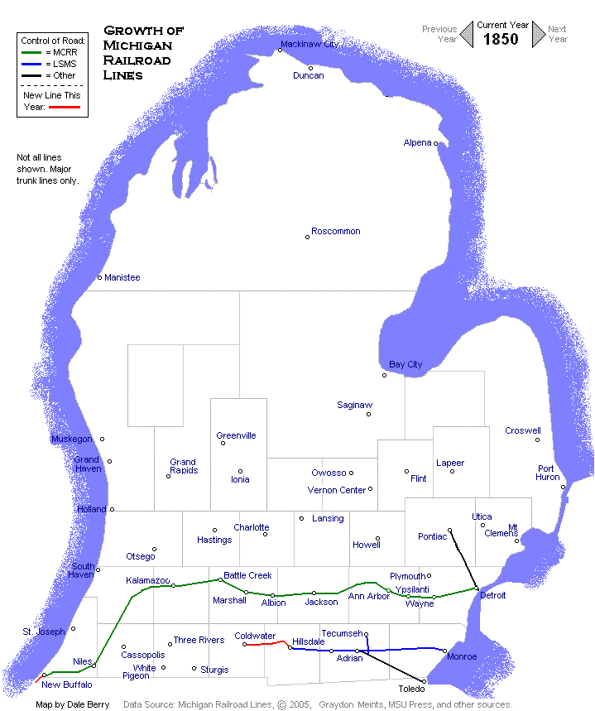
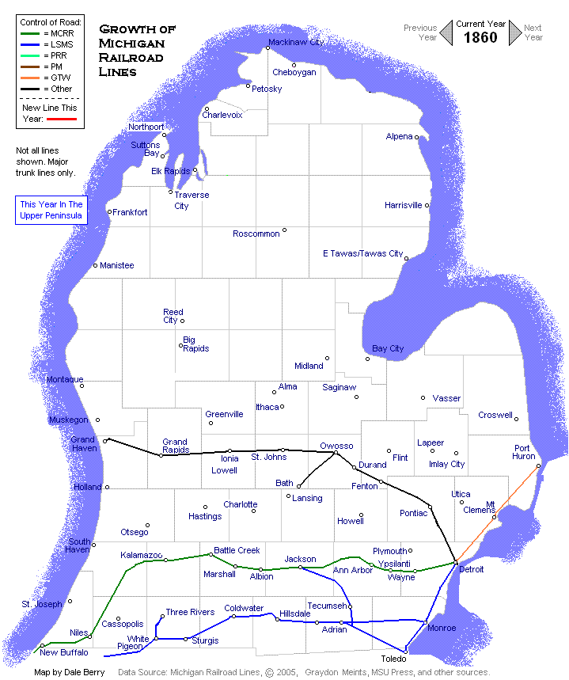
Railroad Expansion
http://www.michiganrailroads.com/RRHX/Evolution/1860s/Upper1860.htm
1840
1850
http://www.michiganrailroads.com/RRHX/Evolution/1840s/Lower1840.htm
http://www.michiganrailroads.com/RRHX/Evolution/1850s/Lower1850.htm
http://www.michiganrailroads.com/RRHX/Evolution/1860s/Lower1860.htm
1860 (600 miles)

Slide 45
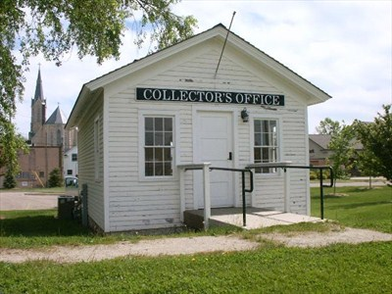
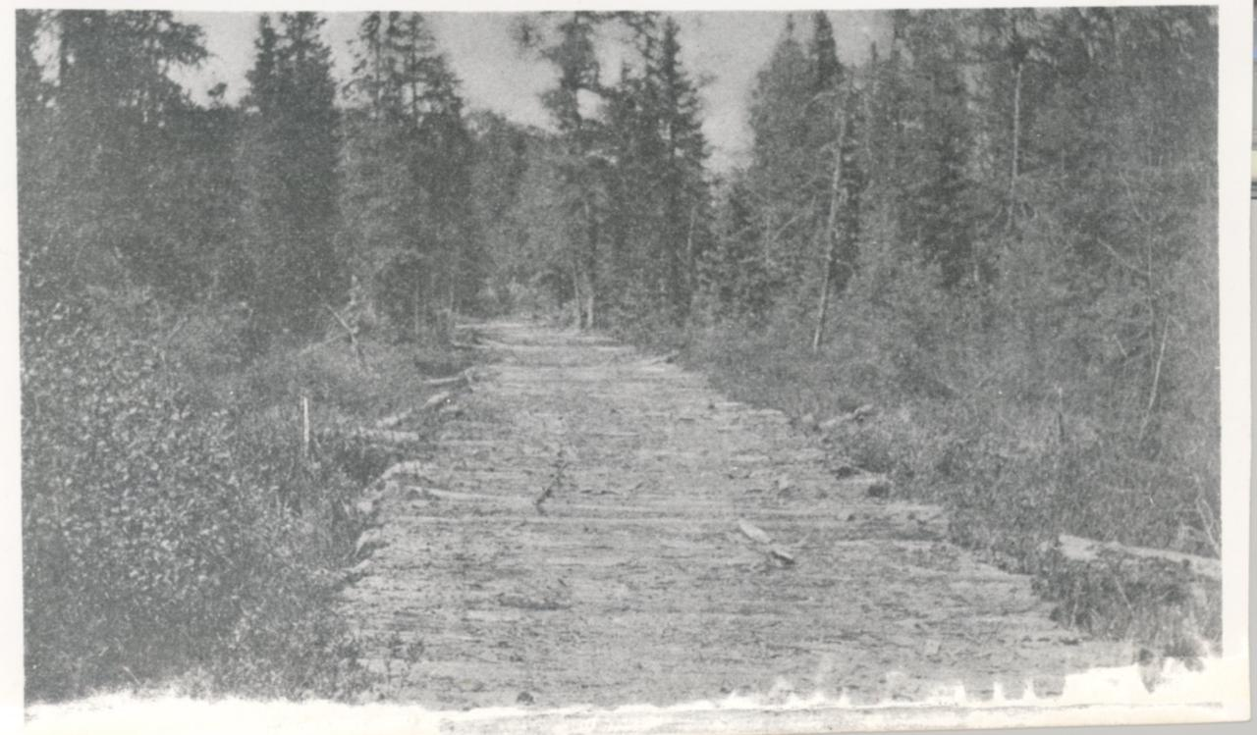
Plank Road Craze
Abundant timber made road building easy and relatively inexpensive
Improvement on “corduroy roads” that were just logs laid in a row
First plank roads were in late 1830s, and were used up until the turn of the century
Road builders charged tolls ($.02/mile) at tollhouses
1855 – started using gravel instead of wood
Taverns (called hotels in the 1860s) grew up along routes
Plank roads quickly deteriorated and became rough
http://www.waymarking.com/waymarks/WM3VZV_Illinois_Michigan_Canal_Toll_House_Ottawa_IL
http://godwin.bobanna.com/ddd.html

Slide 46
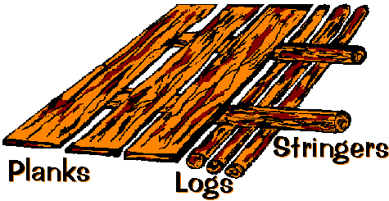
How to build a plank road
Parallel to direction of road
8’ – 16’ long, and 3”-4” thick (pine or oak)
Used in wet areas
Ditches on either side of the road provided drainage. Wagons could pass using a dirt or gravel road alongside the plank road.
http://www.hal.state.mi.us/mhc/museum/explore/museums/hismus/prehist/settling/proads.html

Slide 47
Michigan Internal Improvements Law of 1837
Gov. Mason recommends the state buy stock in railroad and canal-building companies
Set up 7-member Board of Commissioners
Authorized work on 3 railroads and 2 canals
Monroe to New Buffalo on Lake Michigan (southern railroad)
Detroit to St. Joseph (central railroad). Section from Detroit to Ypsilanti done in Feb. 1838
St. Clair to Grand Rapids (northern railroad)
Canal from Clinton River to the Kalamazoo River (Clinton-Kalamazoo Canal)
Canal from Saginaw to the Grand River
State issued $5 million in bonds to fund improvements

Slide 48
Causes of Panic of 1837
Specie Circular – Pres. Jackson says that only gold and silver can be used to buy land
Britain demands repayment of debts which depletes specie supply
Banks had to give states the federal surplus in specie, but ran out, so notes became worthless. Customers rushed to withdraw money from banks.
Effect of panic didn’t hit Michigan until 1839, when firms went bankrupt, unemployment rose, and commodity prices (crops) fell
Michigan sold $5 million in bonds to former Bank of the United States, who ultimately only paid $2.6 million, despite promises to make quarterly payments of $250,000. Funding for internal improvements dried up in 1840. Mason was strongly criticized.

Slide 49

The Panic sets in
http://en.wikipedia.org/wiki/William_Woodbridge
Democrat Mason vs. Whig William Woodbridge in 1839. Conservatives won, and Woodbridge became governor.
Panic of 1837 lasted until the mid-1840s. Only a small portion of Saginaw-Grand Canal and Clinton-Kalamazoo Canal was completed (from Mt. Clemens to Rochester). Remaining funds went into southern railroad (stopped at Hillsdale, sold for $500,000) and central railroad (stopped at Kalamazoo, sold for $2 million). Michigan stopped doing any internal improvements (put this in 1850 Constitution)
1839 – Only four banks still in operation
1845 – Only 3 banks in Michigan with gold coins and a limited number of silver dollars

Slide 50
Patriot’s War (Canadian Rebellion of 1837)
1837-1842
French in Quebec want independence from Britain, as do some Canadians
Patriots = Canadians rebelling against Britain, aided by Americans (Hunter’s Lodges). Mason ordered the arrest of anyone aiding the Canadians, but he sympathized with patriots.
Gen. Hugh Brady, U.S. commander of the army in Detroit, tried to stop patriots from launching attacks, so the U.S. could remain neutral.
Battle of Windsor – British kill 21 patriots, and hang 4 in Dec. 1938.
Webster-Ashburton Treaty ended war

Slide 51
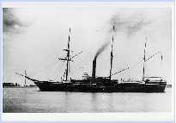
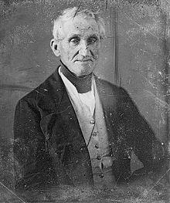
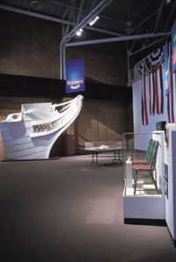
USS Michigan
http://civilwartalk.com/threads/the-first-iron-warship-of-the-us-navy-the-uss-michigan.90659/
http://en.wikipedia.org/wiki/Hugh_Brady
First iron-hulled warship in the U.S. Navy was launched in 1844 in Erie, PA.
Gen. Hugh Brady, the namesake of Fort Brady in Sault Ste Marie, had a long military career from the 1790s to the 1840s. He died being thrown from a carriage at age 83.
The prow of the USS Michigan can be found at the Erie Maritime Museum in Erie, PA.
http://www.acbs.org/rudder/oldrudder/Rudder/Fall2001/ErieMaritimeMuseum.htm

Slide 52
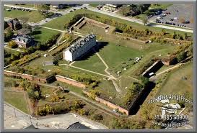
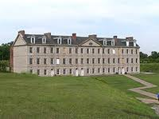
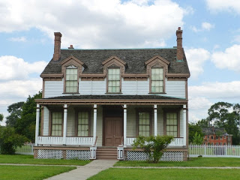
Fort Wayne
Started in 1843, completed in 1851 for $150,000
No hostile shots fired, but British sympathy for the South during the Civil War caused concern about Canadian invasion. Served as a mustering center for troops.
http://www.aerialpics.com/E/fort-wayne.html
Not open to the public except for special events
Barracks
http://en.wikipedia.org/wiki/Fort_Wayne_(Detroit)
Garrisoned until 1941, it housed CCC volunteers during the Great Depression, and 2,000 workers in Motor Supply Depot during WWII. Also housed families displaced by 1967 riot.
Commander’s House
http://www.usforts.com/2013/08/fort-wayne-detroit-michigan.html

Slide 53
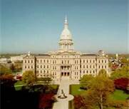
Capital moves to Lansing (1847)
Constitution of 1835 said capital would be Detroit for 10 years
Choice between Detroiters (pop. 13,065) and “outstaters”: Jackson, Ann Arbor, Battle Creek, and Albion.
James Seymour donated 20 acres in Ingham County which was wilderness with no close railroads
Town was to be called “Michigan,” but changed to Lansing (named for Lansing, NY) in 1848. Lansing is only capital that is not also a county seat.
Detroit was too close to Canadian border if war with Great Britain broke out
Detroit also had too many taverns (420 salloons and 23 breweries)
The present capitol was built in 1879.
http://www.cityprofile.com/michigan/michigan-state-capitol.html

Slide 54
Michigan tries to attract settlers
Sells land cheap
Advertise (The Emmigrant’s Guide to Michigan – 1848)
Develop ethnic communities (Germans, Dutch, etc.) by granting land

Slide 55
Canadian Immigrants
Fled after the failure of the 1837 rebellion
Many fled to U.S. in 1800s due to slow economic growth in Canada

Slide 56
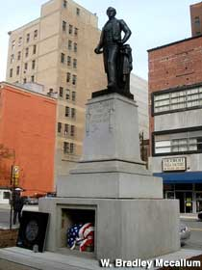
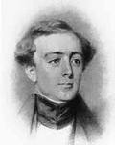
Stevens T. Mason
http://www.roadsideamerica.com/blog/detroits-historic-dead/
1841 – Left Michigan for New York to start career in law
1843 – Died at age 30, buried in NYC
1905 – Body moved to Capitol Park in Detroit, site of old Capitol building
http://www.wlcsd.org/Loonlake.cfm?subpage=633283
1955 – Body moved to make room for bus station.
2009 – Detroit announces it will move body several yards, but workers could not find body for four days.
2010 – Body buried for 4th time under statue
Mason’s statue and tomb today at Griswold and State Street (Capitol Square Park).
Mason was the first governor of the State of Michigan, and the youngest governor ever at 23 years old

Slide 57
6 Economic Activities from 1835-1860 –
Extractive Industries
Fur Trapping (dying in the mid 1800s, so American Fur Company switched to fishing)
Farming (#1 industry in mid 1800s)
Lumbering (#2 industry in mid 1800s)
Fishing (#3 industry)
Mining (#4 industry)
MANUFACTURING (make products)

Slide 58
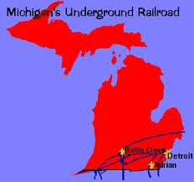
Detroit’s role in the Underground railroad
http://www.hal.state.mi.us/mhc/museum/explore/museums/hismus/prehist/civilwar/undergro.html
Most routes went from Missouri or Kentucky, and ended in Detroit, Port Huron, Mount Clemens, or even Sault Ste. Marie. Slaves walked or rode in wagons covered with hay during the night to the next “station.” The “stationmaster” knew only the next station, never the previous one. Coded messages in local newspapers alerted stationmasters about runaways. More than 50,000 slaves reached Canada, perhaps 45,000 through Detroit from 1833-1863.
Slaves = “Fares”
Escape routes = “Lines”

Slide 59
Thornton Blackburn - 1833
Detroit’s first race riot occurs when blacks aided a runaway slave named Thornton Blackburn and his wife.
Whites attack and kill sheriff that tries to arrest Blackburn, who then escapes to Canada.
Anti-slavery movement starts in Detroit.
1836 – Second Baptist Church organized by 13 former slaves (first Negro church in Detroit), who play a key role in aiding escaped slaves.

Slide 60
Detroit aids fugitive slaves
1837 – Detroit Anti-Slavery Society forms
1847 – Michiganders help Adam Crosswhite to escape to Canada, but are forced to pay $1,925 in restitution (raised by abolitionists)
1847 – Mob attacks Missouri slave catcher trying to reclaim Robert Cromwell, who escaped to Canada.
1850 – Fugitive slave law made aiding slaves a federal crime
1855 – Personal Liberty Law – MI forbids use of county jails to hold escaped slaves, and prosecutors must defend them.

Slide 61
WAVES of IMMIGRATION
1825 - Germans
1830s – Irish come to work on railroads (many flee Irish Potato Famine in 1845-1852)
1848 – “48ers”- German, Czechs, and Hungarians (scholars, scientists, journalists, teachers, and lawyers) flee
1849 – Scandinavians come to work in mines and forests
1855 – Italians
1857 – Polish

Slide 62
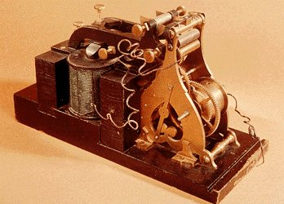
Communication Breakthrough
Telegraph – Samuel Morse – 1844
1848 – First telegraph message between Detroit and Buffalo.
By 1860, most large cities in Lower Peninsula had telegraph service, but U.P. wasn’t until after the Civil War. Many companies competed for telegraph service.
Telegraph allowed news to spread almost instantaneously (people could read newspapers a day later)
The first message received by Morse Code
was “What hath God wrought?”
http://www.wrvmuseum.org/morsecodehistory.htm

Slide 63
Funding Education
Constitution of 1835 created nation’s only superintendent of public instruction (John Pierce) appointed by governor
Public land sales in Section 16 (over 1 million acres @ avg. $4.58/acre) went to the states rather than the township, and must be used solely for education (put in the Primary School Fund, and the interest goes to schools)
Schools must be open at least 3 months a year
Township libraries established

Slide 64
EDUCATION IN Detroit
1837 – Detroit divided into 7 school separate school districts
1842 – Detroit creates a single school district with a Board of Education, and Michigan’s first public school system, with free education for all from public funds

Slide 65
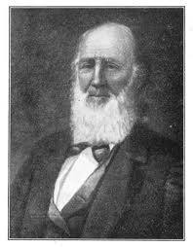
John D. Pierce
http://www.gutenberg.org/files/21532/21532-h/21532-h.htm
Michigan’s first Superintendent of Public Instruction.
Pierce had to implement the education article of the 1835 Constitution, and organize the public school system. Oversaw the sale of lands granted for building and maintaining schools, and the Primary School Fund.
He wanted a system of tax-supported public schools which would cost students nothing (finally accomplished in 1869). Prior to this, school were private, church-based schools
He wanted compulsory education (finally accomplished in 1871 for kids age 8-14). Raised to 16, and raised to 18 in 2010.
He wanted teachers to be trained, and they would be paid a minimum wage.

Slide 66
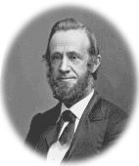
1860
http://bay-journal.com/bay/1he/people/fp-cooley-edgar.html
4,087 school districts (75% went to public schools) Mostly one-room schoolhouses, and most of the 7,921 teachers had no training.
1842 – Detroit become first community to offer free education to all residents
1859 – School districts with over 200 children must have a high school, and a tax to support it (though many opposed it)
1874 – Michigan Supreme Court Justice Thomas Cooley rules that high schools are constitutional (“Kalamazoo Case”)
Thomas Cooley

Slide 67
Land grants from the federal gov’t
Create 3 universities (Michigan State Normal School, Michigan Asylum for the Insane at Kalamazoo, and the State Agricultural College) with money from sale of 72 sections
Morrill Act (1862) – Feds give 240,000 acres to Michigan to sell to fund the Michigan State Agricultural College to teach the latest farming techniques and mechanical arts (weaving, blacksmithing, military arts, engineering).
Land grants funded U of M (1817), MSU (1855) and EMU (1849) and encouraged townships to establish schools well before they might have

Slide 68
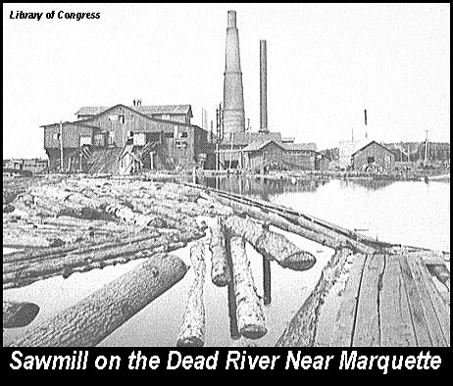
The beginning of manufacturing
Lumber created in sawmills
Boots, shoes, flour, barrels, furniture, wagons
http://uptreeid.com/History/LogEra.htm

Slide 69

Transportation AND SHIPPING
Ships carried far more than railroads in mid 1800s after the construction of the Erie Canal in 1825, and the Welland Canal in 1833 (bypass Niagara Falls), and the Soo Locks in 1855. Riverboats carried passengers and grains, meats, and farm products.
St. Joseph was a more important grain and flour port than Chicago, and second to Detroit.
Detroit and Cleveland Navigation Company formed in 1850, carrying passengers around the Great Lakes
Detroit Dry Dock Company starts in 1852, and boat building becomes a significant business.
Canals became less popular in 1840s with rise of railroads
http://www.labeltrader.com/store/index.php?main_page=index&cPath=1

Slide 70



Technology in Detroit
1825 – First cobblestone streets in Detroit
1836 – First street signs
1851 - Gas lights replaced candles
1861 – Kerosene replaced whale-oil lamps
Water system, indoor plumbing
1860 – Sewing machine
Stoves, bathtubs, ice machines
http://www.antiqbuyer.com/Archive-Sewing.html
http://en.wikipedia.org/wiki/Wood-burning_stove
http://www.floridastateparks.org/history/parkhistory.cfm?parkid=34

Slide 71

Newspapers
Partisan papers supported either Democrats or Whigs (Republicans after 1854).
Detroit Free Press started in 1831
Detroit Free Press supported the Democrats, while the Detroit Tribune (later called the Advertiser and Tribune in 1858) supported the Whigs. Detroit had three daily papers by 1850.
Many papers sprung up, but were short-lived.
Little local news; most papers were weeklies.
http://detroit1701.org/Detroit%20Free%20Press%20Building.html

Slide 72

Both copper and iron mining began in the UP in the 1840s after the federal gov’t bought the land from the Indians in 1842.
Keweenaw Peninsula
Marquette
(first iron mines)
http://www.hal.state.mi.us/mhc/museum/explore/museums/hismus/prehist/mining/iron.html

Slide 73


The “Great Michigan Copper Rush”
http://en.wikipedia.org/wiki/Douglass_Houghton
Started in 1843 after State Geologist Douglass Houghton’s report and the publicity of the Ontonagon Boulder.
Reached peak in 1846, three years before California gold rush.
Copper mined over 150 years (1845-1995) had more value and importance than the gold in California.
For 40 years (1847-1887), Michigan led the nation in copper production, although the peak of production was just before World War I (1905-1912).
Henry Schoolcraft found copper during 1820 Cass Expedition (the Ontonagon Boulder). The original boulder is owned by the Smithsonian Institute, and this replica is in the Ontonagan Historical Museum.
http://en.wikipedia.org/wiki/Ontonagon_Boulder

Slide 74



Iron Ore
http://www.surveyantiques.com/meet_your_maker.htm
Discovered by surveyor William Burt in 1844 in Negaunee (west of Marquette). Burt later invented the solar compass to make surveying in iron country more accurate.
Michigan led the nation in iron production until 1900
Production peaked in 1920 when copper was declining
Most iron goes into steel production, which can be 1,000 times harder than pure iron.
In 1848, the Jackson Iron Company, lead by Philo Everett, opened the first iron mine (Jackson Mine)
Negaunee is home to the Michigan Iron Industry Museum
http://en.wikipedia.org/wiki/Jackson_Mine
https://roadtrippers.com/us/negaunee-mi/attractions/michigan-iron-industry-museum

Slide 75


Immigrants
Scotland
Wales
Cornwall
http://www.worldatlas.com/webimage/countrys/europe/euscan.htm
http://en.wikipedia.org/wiki/Cornwall
Cornish from SW England (Cornwall) worked in copper and iron mines in U.P., with many other foreign-born workers, mostly Scandinavians
Lumbering attracted French-Canadians, Swedes, and Norwegians
Farming attracted the Danes in central Michigan
Only 20,000 people in Upper Peninsula in 1860. Only 1,500 lived there in 1834.

Slide 76


The long career of Lewis Cass
1813 -1831 – Governor of Michigan Territory
1831-36 – Secretary of War under Pres. Jackson (implemented Indian Removal Policy)
1836-1842 – Minister to France
1844 – Lost Democratic nomination to James Polk
1845-48 – U.S. Senator
1848 – Lost to Zachary Taylor in presidential race
1849-57 – U.S. Senator
1857-1860 – Secretary of State to James Buchanan
http://www.nndb.com/people/224/000050074/

Slide 77
Constitution of 1850
100 delegates met for 2 ½ months
Twice as long as Constitution of 1835
Powers of the legislature were restricted, because congressmen used power to give favors to their business interests (no internal improvements)
Almost all state officials had to elected, even Supreme court justices (weakened the spoils system)
Banking law reforms needed majority vote of the people
$50,000 limit on public debt
No state aid for internal improvements

Slide 78

Constitution of 1850
State Reps serve two years not one
Elections on same year as national elections, so ballots were longer and national issues dominated
8 circuit courts replace county courts, and the elected judges serve on the supreme court
Free schools operate at least 3 months a year, but not totally free until 1869.
No suffrage for blacks, but Indians could vote if renounced tribal loyalty.
http://books.google.com/books/about/Journal_of_the_Constitutional_Convention.html?id=l5PhAAAAMAAJ

Slide 79
Constitution of 1850
Aliens who wanted to become U.S. citizens could vote
“Civilized” Indians could vote
Blacks could not vote (residents rejected a proposal to allow with 72% of vote)
Lasted until 1919, with 38 amendments adopted
Michigan’s worst constitution

Slide 80


The Birth of the Republican Party (1854)
http://www.jacksonmich.com/markers/mark1.htm
Feb. 1854 – Opponents (Democrats and Whigs) to the Kansas-Nebraska Act (popular sovereignty to determine slavery) met in several Michigan cities
May 1854 – Agree to form a new party
July 6, 1854 – In Jackson, MI, 1,500-6,000 people gathered “under the oaks” to form the Republican Party opposed to expansion of slavery even under popular sovereignty. Wanted repeal of Kansas-Nebraska Act and Fugitive Slave Act.
Zachariah Chandler was one of the founders, and he was the party “boss” in Michigan until his death in 1879.
http://www.answers.com/topic/zachariah-chandler

Slide 81


The Soo Locks - 1855
Shipment of iron greatly increased
1855 – 1,449 tons
1860 – 114,401 tons
http://www.answers.com/topic/sault-sainte-marie-canals
The Northwest Fur Company built locks as early as 1797.
Sen. Henry Clay of Kentucky called the Soo Locks “a work quite beyond the remotest settlement of the United States if not in the moon.”
http://southernnationalist.com/blog/2010/12/05/the-real-henry-clay/

Slide 82

Charles T. Harvey
Charles Harvey convinced the Fairbanks Scale Company to start construction of the locks in 1853
John W. Brooks took over construction in 1854, and finished it.
Built for $1 million (double the estimate)
Michigan owned until 1881, then became federal
http://voices.nmu.edu/content.asp?PageName=Yankees

Slide 83

The Growth of Detroit
1857 – The first big hotel opens (the Russell House, replaced by the Pontchartrain Hotel in 1907)
Russell House @ 1900
http://forum.skyscraperpage.com/showthread.php?t=118394&page=5

