Slide 1
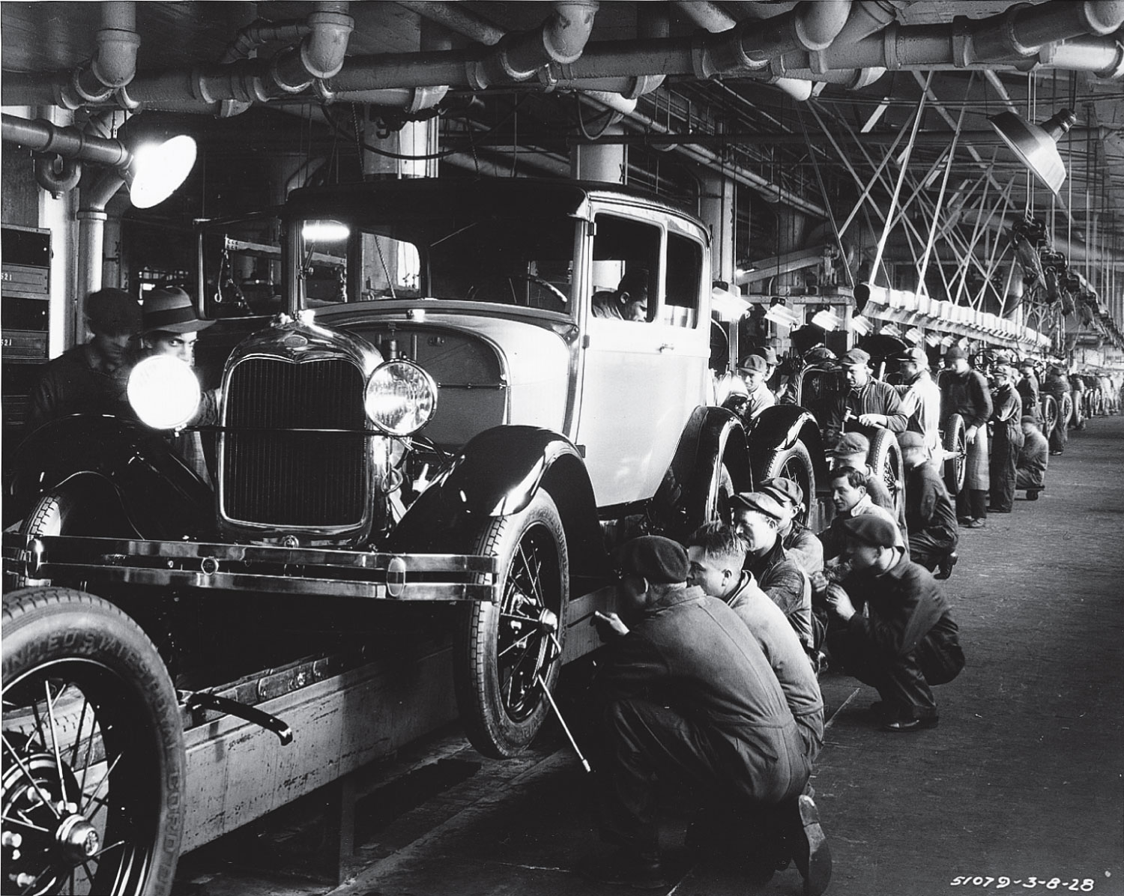
Birth of the motor city
http://www.canoelover.com/?attachment_id=1091
1900-1929

Slide 2
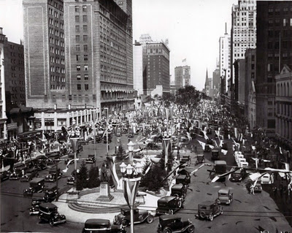
Detroit: “Paris of the West”
http://and1morefortheroad.blogspot.com/2012/01/last-word.html
Washington Blvd. was very fashionable
139 sq. mi. of bedroom communities
1900 – Detroit ranked #13 among cities
Population doubled between 1910-1920 : 450,000 to 1,000,000
4th largest city other than New York, Chicago and Philadelphia from 1920-1940
1950 was peak of population at 1.85 million, when LA overtook, so 5th largest U.S. city from 1950-1970.

Slide 3
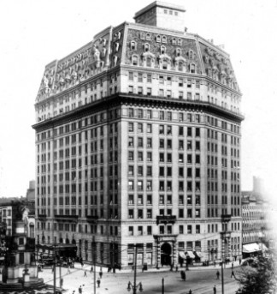
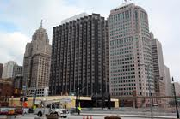
“The Pontch” replaces the Russell House
The Pontchartrain Hotel is built on site of old Russell House (built in 1857) in 1907. Owned by the Detroit Hotel Company, a syndicate led by estate of James McMillan and Dr. E.M. Clark, owner of the property.
Built for $1 million (about $25 million today)
Doris McMillan, granddaughter, was first to sign the hotel register.
Henry B. Joy, president of the Packard Motor Car Company, complained in 1911 that the Pontch was the only place to meet, so he rebuilt the Detroit Athletic Club in 1913. The Statler Hotel was built in 1915 with bathrooms in each room and air conditioning. The Pontch was outdated by 1917, and demolished in 1920.
Ty Cobb, a racist and the most famous Detroit Tiger, drank there.
New “Pontchartrain Hotel” was built on Jefferson, on site of old Fort Pontchartrain, in 1965
http://www.lansingstatejournal.com/article/C4/20121125/FEATURES05/311250034/Excerpt-from-Dan-Austin-s-Forgotten-Landmarks-of-Detroit-
http://online.wsj.com/news/articles/SB10001424052748703730704576066043187920376

Slide 4
5 kinds of Progressives
Social Reformers: improve life for the poor
Labor Reformers: better hours, conditions, wages, materials
Political Reformers: bigger gov’t role in all facets of life, include more people in political process (suffragettes)
Moral Reformers: Prohibition
Technocrats: standardize and rationalize processes

Slide 5
Progressive Trends 1896-1917
Industrialization – factories, not cottage industry
Urbanization – cities become place to live
Specialization – de-skilling and alienation
Mechanization – technology replaces workers, creates more leisure time, make goods cheaper
Standardization – scientific principles to create order (assembly line, building codes, etc.)
Nationalization – national businesses tied by rail
Immigration – Jews and Europeans
Migration – blacks move North for jobs
Consumerization – advertising creates demand
Professionalization – ABA, AMA increase competency

Slide 6
Reforming City Government
Municipal reform = change the structure and function of city gov’t (eliminate corruption and inefficiency)
Wards vs. Citywide election of council members (citywide preferred to address needs of whole city, not a particular neighborhood)
Commission system = voters elect commission to handle a specific city function
City Manager = professional hired by city council to run handle city administration and report back
City planning = zoning
Public Health issues (tuberculosis), clean water, sewers
Public schools (professional superintendents not elected), greater centralization, IQ tests to help students

Slide 7
The Weakening of Parties
  Many states adopted direct primary to replace nominating conventions, so candidates had to appeal to voters, not political bosses or convention delegates. With secret ballot, voter turnout fell.
  Merit system replaced state patronage system
  Judgeships, school board seats, and educational offices were made nonpartisan
  Oregon System
  Initiative = people vote directly to create a new law
  Referendum = people vote directly to overturn an existing law
  Recall = special election to remove politician from office
  Direct Democracy = recall, initiative, referendum

Slide 8
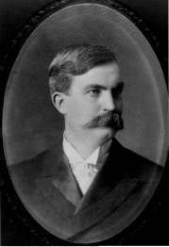
McMillan “machine” ends
James McMillan died in 1902 at age 64, and his senate seat was taken by Russell Alger. William C. McMillan, his son, continued in politics until his death in 1907 (45 years old).
McMillan backed Republican Fred Warner to replace Aaron Bliss as governor in 1904.
Warner, the only governor to serve three terms (1905-1911), pushed for direct primary to replace nominating convention (finally enacted in 1909), and other progressive reforms
http://medicolegal.tripod.com/michiganlaw.htm
Fred Warner

Slide 9
Constitution of 1909
96 convention delegates (elected) (mostly conservative Republicans, not progressives)
Largely kept 1850 Constitution intact
Initiative and referendum were rejected
Cities could own public utilities
Legislature could pass laws limiting hours worked by women and children and regulate conditions

Slide 10
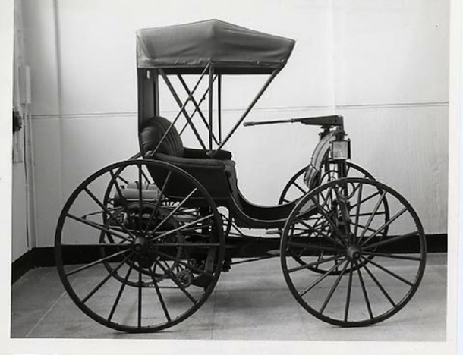
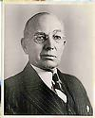
The Development of the “horseless carriage”
In 1893, Frank Duryea of Illinois tested the first “horseless carriage” in the U.S.
In March 1896, Charles B. King tested first gas car in Michigan, but never launched a car company
In June 1896, Henry Ford tested his “quadricycle”
Ransom Olds was the true pioneer of mass-producing gasoline-powered cars
Frank and Charles Duryea made the first successful commercial automobile in 1893 in Springfield, Mass. The Duryea Motor Wagon Company was the first American auto company in 1895.
Frank Duryea
http://connecticuthistory.org/frank-duryea-drives-the-first-automobile-in-connecticut/

Slide 11
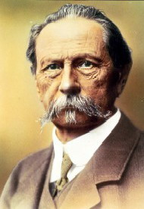
Who did it first?
http://en.wikipedia.org/wiki/Karl_Benz
Karl Benz – made first gasoline powered car
Frank Duryea – made first commercial automobile, and started first automobile company in the world (Duryea Motor Wagon Company in 1895)
Ransom Olds – made first mass-produced car using first assembly line (1901 Olds Curved Dash)
Henry Ford – first moving assembly line (1913 Highland Park Plant – entire chassis of car) made Model T’s in far greater quantities which made them more affordable (“brought cars to the masses”)

Slide 12
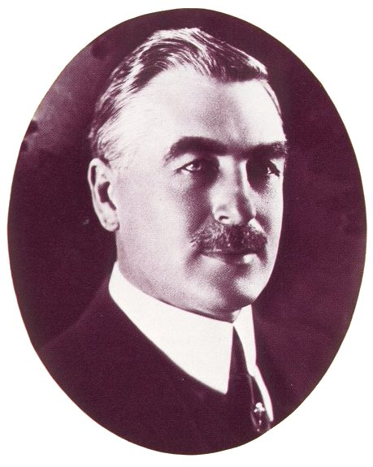
Detroit’s first auto show
1895 – London hosts world’s first auto show. William Metzger of Detroit attends, and then visits Karl Benz and Gottlieb Daimler
1897 – Metzger opens the first auto showroom in the U.S. selling Waverley electric cars.
1899 – Metzger sells the first Oldsmobile
1899 – Metzger and Seneca Lewis rent the Light Guard Armory, and display two electric and two steam-powered automobiles.
http://emfauto.org/EMF_history.php

Slide 13
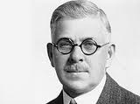
Ransom E. Olds
http://en.wikipedia.org/wiki/Ransom_E._Olds
Olds was the first automobile millionaire
Born in Ohio, he moved to Lansing in 1880 with his father who owned an engine repair shop (P.F. Olds and Son).
1896 – Olds switched from making steam engines to gas engines mostly for marine use. He tested the engine on a car in August, following King and Ford.
1897 – received patent on Olds gasoline automobile, and started the first auto company in Michigan, the Olds Motor Vehicle Company, with $10,000 investment from Edward Sparrow
1900 – Olds built world’s first auto factory near Belle Isle Bridge in Detroit. 11 different models ranging from $1,200-$2,700, but switches to producing “runabouts” in 1901 with one-cylinder engine at price of $600. Sold 425 in 1901, and 2,500 in 1902. The “Olds” Curved Dash was the first mass-produced car in the world.
1902-1905 – Production rose from 3,000 to 6,500 in factories in Detroit and Lansing, but decided in 1905 to move all production to Lansing.
1905 – Olds starts the Reo Motor Car Company after a dispute with a major investor. Starts making heavier, more expensive cars. Olds was the first man to produce cars in significant numbers. He influenced several former employees and suppliers to build their own cars.

Slide 14
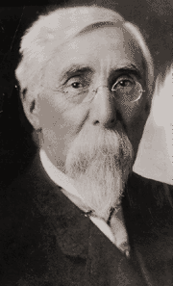
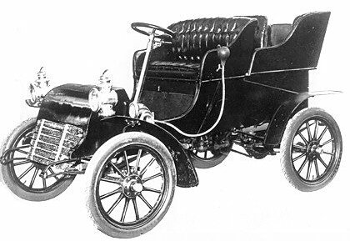
Henry M. Leland: the “forgotten” auto pioneer
Produced engines for “Oldsmobiles.” He redesigned the valve ports and raised its compression and offered it to Olds, who turned him down, as did Henry Ford in 1902.
Demonstrating an engine small enough for one man to carry, Leland sought the help of Detroit investors who formerly backed Henry Ford.
1902 – Cadillac Automobile Company formed from the old Henry Ford Company to compete with the Oldsmobile runabout. By 1904, it was producing luxury cars. Chose the name of Detroit’s founder rather than himself.
1917 – Formed the Lincoln Motor Company with his son, Wilfred, and made Liberty aircraft engines during WWI, but soon went bankrupt.
1922 – Bought by Ford, who got revenge on Leland for deserting his Detroit Automobile Company in 1899
http://www.findagrave.com/cgi-bin/fg.cgi?page=gr&GRid=616
http://www.motorera.com/cadillac/cad1900/1903/cad02b.jpg

Slide 15
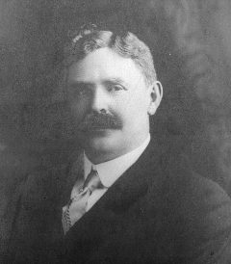
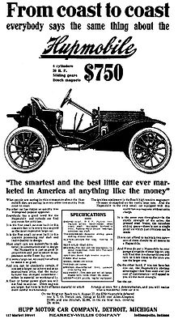
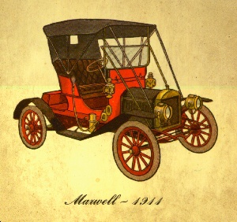
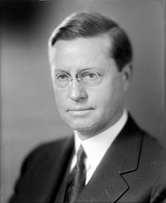
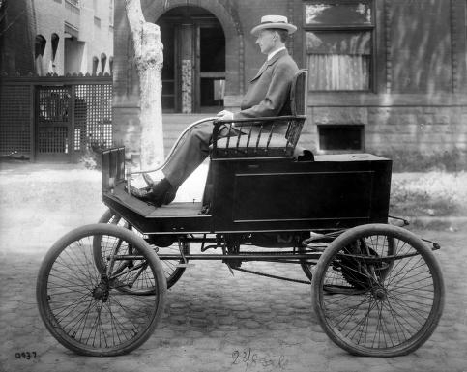
Former Olds employees
Both images: http://www.clanmaxwellusa.com/maxcars.htm
Former Olds employee Jonathan Maxwell builds the Maxwell automobile in 1904, which was later copied by Walter P. Chrysler.
Former Olds employee Robert Hupp makes the Hupmobile in 1908. Ty Cobb was spokesman.
Former Olds employees Roy Chapin and Howard Coffin, backed by department store magnate, J.L. Hudson, formed the Hudson Motor Car Company in 1909. Made the first closed car in the 1920s, and produced cars until 1954.
http://commons.wikimedia.org/wiki/File:Hupmobile_1909-0905.jpg
Howard Coffin built a steam-powered car as a student at U of M.
http://en.wikipedia.org/wiki/Roy_D._Chapin
Roy Chapin later served as the Secretary of Commerce under Herbert Hoover.
http://bentley.umich.edu/research/guides/automotive/

Slide 16
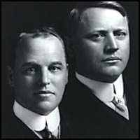
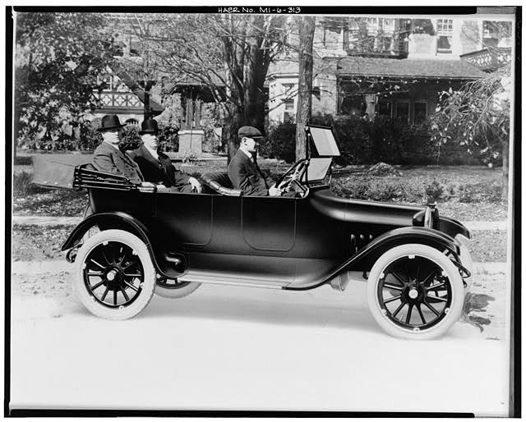
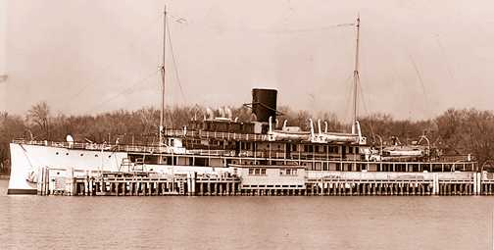
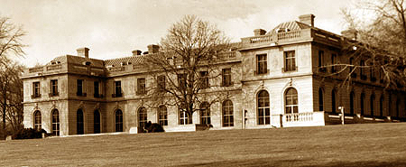
John and Horace Dodge
http://www.dodgemotorcar.com/history/early_history.php
1900 – Like Henry Leland, the Dodge brothers made engines for Oldsmobiles. Formed the Dodge Brothers Company.
1903 – Dodges supply parts for Henry Ford’s Model A, and bought stock in Ford Motor Company. Ford bought them out in 1919.
1914 – Start making their own vehicles, and amass a fortune of $200 million ($2 billion today).
Both brothers died in 1920.
1914 Dodge
http://www.allpar.com/cars/dodge/dodge-cars.html
http://www.greeceyachts.com/delphine_yacht_history.htm
http://marshallfredericks.org/archives/1320
Rose Terrace, rebuilt in 1930 by Anna Dodge, Horace’s widow, was the most luxurious home in Grosse Pointe. She remarried, and lived until 1970 (age 99). The Dodge also owned the largest private yacht, the 257’ Delphine, named for Horace and Anna’s daughter.

Slide 17
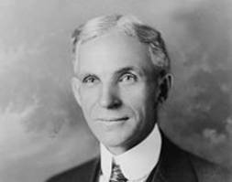
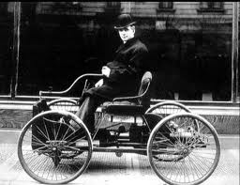
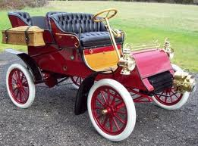
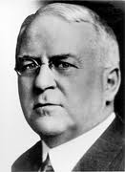
Henry Ford
http://narimanshatayev.blogspot.com/p/henry-ford.html
http://www.imcdb.org/vehicle_298690-Ford-Quadricycle-1896.html
1863 – Born in Dearborn on a farm
1879 – Fired from job at Michigan Car Company
1880-82 – Worked on engines at Detroit Dry Dock Company
1891 – Worked for Edison Illuminating Company as electrical engineer trying to perfect internal combustion engine
1893 – Chicago World’s Fair inspired Ford, like Olds, to switch from steam to gas engines
1896 – Builds the Quadricycle
1899 – Ford starts the Detroit Automobile Company. Many investors (including William C. McMillan with 100 shares) gave Ford a factory, equipment, and laborers. Failed because Ford lacked manufacturing experience like Olds. Ford was perfectionist who wanted to correct all flaws before production. With no cars, investors bailed on Ford in late 1900, and backed Henry Leland’s Cadillac. 300 auto companies started from 1896-1908, but most failed.
1901 – Beats famous race car driver Alexander Winton in race in Grosse Pointe. The next year, Barney Oldfield drives Ford’s race car to victory again. His second company, the Henry Ford Co. fails
1903 – Starts Ford Motor Company making the Model A. James Couzens was the treasurer, who insisted Ford ship out the cars despite defects. Only $28,000 ($700,000 now) raised by investors.
Quadricycle
http://blog.hemmings.com/index.php/2009/11/02/hemmings-find-of-the-day-1903-ford-model-a-and-1903-stevens-duryea-l/
1903 Model A
(price = $900)
http://en.wikipedia.org/wiki/James_J._Couzens

Slide 18
Henry ford’s dream
"I will build a car for the great multitude. It will be large enough for the family, but small enough for the individual to run and care for. It will be constructed of the best materials, by the best men to be hired, after the simplest designs that modern engineering can devise. But it will be so low in price that no man making a good salary will be unable to own one – and enjoy with his family the blessing of hours of pleasure in God's great open spaces.”

Slide 19
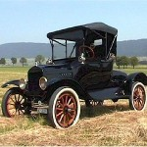
Model T (1908-1927)
After the Model A, Ford made Models B (first four cylinder), F, K, N, R, and S.
Work began in 1907, and introduced in Oct. 1908 for $825. Eventually sold for $360 in 1916. Affordable Model T “put America on wheels.” Easy to fix with interchangeable parts. Developed rattles, so called “Tin Lizzie.” Only color available was black.
1913 – Highland Park plant with moving assembly line was birth of mass production. Cars that once took 12 hours to build now took only 90 minutes. Ford got idea from conveyor belts at Chicago slaughterhouse.
By 1927, Ford made 15 million Model T’s.
http://econhist.econproph.net/2012/12/henry-ford-changing-the-automotive-industry/

Slide 20
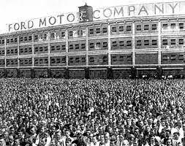
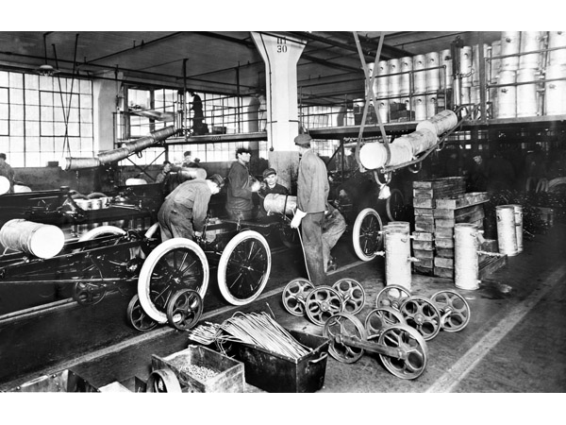
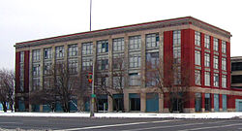
Highland Park Plant, 1913
http://coildoctor.com/historical_sights
This 1915 Highland Park plant photo included workers from 53 nationalities.
http://sites.duke.edu/ragtime/category/general-dramaturgy/page/3/
In 1914, Ford shocked the nation by paying his workers $5 per day at a time when $2.34 per day was normal. The assembly line made cars eight times faster than any other plant in the world.
What remains of the factory is a National Historic Landmark, but is not open to the public
http://en.wikipedia.org/wiki/Highland_Park_Ford_Plant

Slide 21
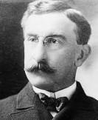
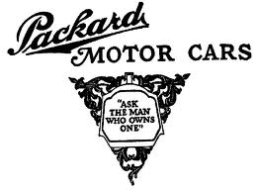
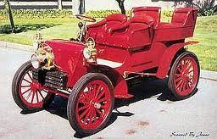
Henry B. Joy and Packard
http://en.wikipedia.org/wiki/Henry_Bourne_Joy
Henry Joy was born in Detroit in 1864, the son of Michigan Central Railroad president James F. Joy.
After seeing a Packard, he invested with Packard founder, James Ward Packard, along with other Detroit investors like brother-in-law Truman Newberry and William C. McMillan. In 1902, the Ohio Automobile Company became the Packard Motor Car Company. Joy convinced Packard to move to Detroit in 1903.
1902 Packard Model F
http://en.wikipedia.org/wiki/Packard
http://oldcarandtruckpictures.com/Packard/

Slide 22
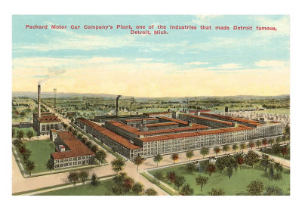
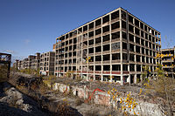
The Packard Plant
The Packard plant was built in 1907 by Albert Kahn, and was 3.5 million sq. ft. over 40 acres. It closed in 1958, and has been vacant ever since. It was purchased in Dec. 2013 by a Peruvian investor, who will spend $350 million to redevelop the site.
http://www.examiner.com/article/auto-pop-culture-graffiti-artist-banksy-hits-motor-city-to-tag-packard-auto-plant-his-message
http://en.wikipedia.org/wiki/Packard_Automotive_Plant

Slide 23
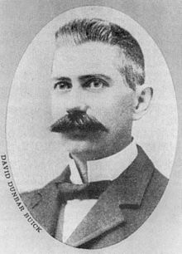
David D. Buick
http://en.wikipedia.org/wiki/David_Dunbar_Buick
Expert plumber started the Buick Motor Company in 1903 aided by Benjamin and Frank Briscoe
Buick poorly managed his company, so Billy Durant took complete control in 1904. In 1908, Buick sold to Durant, who made it part of GM.
Buick used the Durant-Dort factory to build Buicks, and entered them in car races
Louis Chevrolet learned about engines at Buick
By 1908, Buick was as popular as the Ford Model T

Slide 24
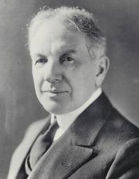
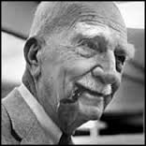
Billy Durant and General Motors
http://www.tomorrowstechnician.com/Article/36096/report_card_highlights_to_gms_historic_anniversary.aspx
Durant didn’t agree with Ford’s one model idea, so he decided to offer a variety of models and styles, so he tried to merge several auto companies together (Ford, Buick, Maxwell-Briscoe, and REO).
Talks with Ford and Olds broke down, so Durant incorporated General Motors in 1908 in New Jersey, which had lax corporation laws. General Motors owned stock in companies that produced cars, but made none itself. Olds Motors Work merged in late 1908, and Cadillac in 1909. Oakland Motor Car Company (eventually called Pontiac) was also merged in 1909.
Charles S. Mott’s company, which made wheels and axles, merged with GM, and he was once the largest holder of GM stock (which was estimated at one time to be worth $800 million). Mott sat on GM’s board for 60 years until his death in 1973.
http://www.automotivehalloffame.org/inductee/charles-mott/100/

Slide 25
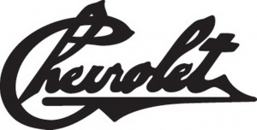
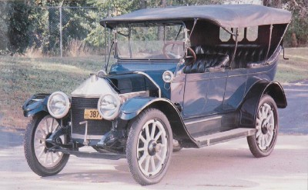
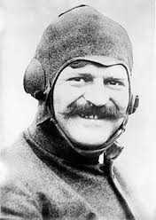
Louis Chevrolet and Billy Durant
http://thelsxdr.com/the-history-chevrolet-bowtie/
1910 - Durant accepted loan that prohibited him from managing GM for 5 years.
Durant then established the Chevrolet Motor Car Company in 1911, named after Louis Chevrolet, the race car driver for Buick. Below is the 1911 Series C.
In 1915, the Chevrolet became a very popular car, and Durant used money to regain control of GM
In 1915, Louis Chevrolet sold his stock to Durant, who merged Chevrolet with GM in 1917. He drove in the Indy 500 four times, but never won,
and died nearly penniless in Detroit in 1941.
http://auto.howstuffworks.com/1911-1912-1913-chevrolet-series-c-classic-six.htm
http://en.wikipedia.org/wiki/Interstate_69_in_Michigan

Slide 26
Detroit quickly becomes the Motor City
By 1904, Detroit was the leader mainly thanks to Ford, Olds, and Leland
1906 – Detroit’s auto production = $12 million (<2% of all manufactured goods in state)
1914 – Detroit’s auto production = $400 million (37% of all manufactured goods in state)

Slide 27
Detroit Auto-Related “Firsts”
1909 – First concrete road in U.S. on Woodward between 6 and 7 Mile Road at a cost of $14,000
1911 – First painted dividing line in center of road on River Road near Trenton (Edward Hines was the Wayne County Road Commissioner)

Slide 28
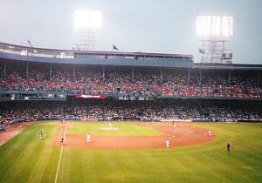
Tiger STADIUM
Built in 1911 as Navin Field (Tigers owner was Frank Navin) on site of old stadium, Bennett Park, which had wooden grandstands
Opened in 1912 on the same day as Boston’s Fenway Park, the oldest MLB stadium
Renamed Briggs Stadium in 1838 for owner Walter Briggs
Renamed Tiger Stadium in 1961 by new owner John Fetzer
Tigers played there until 1999
Lions played there from 1938-74, until moved to the Silverdome.
Demolished in 2008-09
Only the playing field remains today
http://en.wikipedia.org/wiki/Tiger_Stadium_(Detroit)

Slide 29
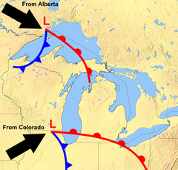
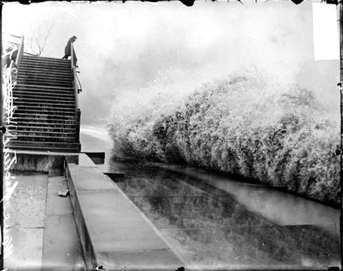
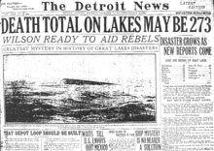
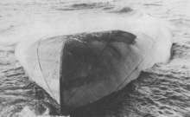
Great Lakes Hurricane of Nov. 1913
Two major storm fronts collided on Nov. 9
Winds were 60-70 mph, with gusts to 90 mph
Waves more than 35 feet high (opposite direction of wind)
Snow squall lasted 16 hours rather than usual 4-5 hours (24 inches)
12 ships were lost (8 on Lake Huron, 2 on Superior, 1 on Erie and Michigan).
255 men died (1953 Flint-Beecher Tornado killed 116)
In aftermath, weather forecasting, communication, and ship design were improved
http://en.wikipedia.org/wiki/Great_Lakes_Storm_of_1913
http://en.wikipedia.org/wiki/Great_Lakes_Storm_of_1913
http://michpics.wordpress.com/2009/11/07/freshwater-fury-the-great-lakes-storm-of-1913/
http://www.crackedhistory.com/worst-storm-ever-strike-great-lakes/
Charles S. Price was a “mystery ship” floating upside down off Port Huron. Identified on Nov. 15, it was the first fully loaded iron ore carrier to capsize on the Great Lakes. 28 men died.
Big wave in Chicago

Slide 30
How the Great War started
6/28/14 - Archduke Franz Ferdinand of Austria-Hungary (ally of Germany and Italy = Triple Alliance) was assassinated by a Serbian, who didn’t like Austria-Hungary annexing Serbia, an ally of Russia, France and Britain = Triple Entente). Austria-Hungary invades Serbia on 7/28/14, and Germany declares war on Russia on 8/1/14, and invades Belgium two days later.
8/4/14 – War begins when Britain declares war on Germany (Central Powers: Germany, Austria-Hungary, Bulgaria, and Ottoman Empire) vs. Entente Powers (Allies) (Britain, France, Russia, and Italy)
Germans tried to march through Belgium, but British and French blocked them, creating 475 mile western front where stalemate occurred

Slide 31
Deadly Technologies
War of Attrition – wear down enemy with continuous losses of men and materiel
First war where more deaths by combat (usually artillery fire) than by disease
Defense easy, offense hard (trench warfare)
Tanks (British, broke down frequently)
Submarines (German U-boats, 5,000 Allied ships sunk)
Machine guns, concrete pill box (guard house)
Dig tunnels, listening devices
Hand grenades
High explosive shells (“shell shock”)
Anti-aircraft guns
Air warfare – bombers, fighter planes, zeppelins

Slide 32
World War I
Total Deaths = 16.5 million (10 million military, 6 million civilian)
American: 126,000 (only in war 18 months)
British: 1.1 million
French: 1.4 million (31% of all who served died, and 44% wounded)
Russian: 1.7 million
Central Powers: 3.5 million
Deaths per day = 5,500 (over almost 4 years)

Slide 33
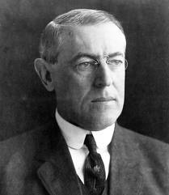
U.S. Tries to Remain Neutral 1914-1917
  Wilson naively believed the U.S. could be “impartial in thought as well in action” and he could be a peacemaker, but both sides wanted territory
  Propagandists exaggerated German atrocities (civilized people vs. barbarian Huns) but 8 million of the 97 million Americans were of German or Austrian descent
http://webpages.scu.edu/ftp/jgiedt/hwv-e-ww.html

Slide 34
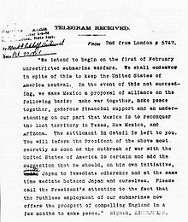
The Decision for War
  Wilson calls for “peace without victory”
  Germans resumed unrestricted submarine warfare hoping to draw the Americans in, but hoped they’d defeat the British and French before the Americans intervened
  Wilson broke off diplomatic relations, so U-boats began sinking Atlantic ships
  March 1917- Zimmerman telegram – British intercept message from German foreign secretary proposing that Mexico should attack U.S. if U.S. enters war, and Mexico will get “lost provinces” of Texas, Arizona, and New Mexico if Germany wins war
http://en.wikipedia.org/wiki/Zimmermann_Telegram

Slide 35
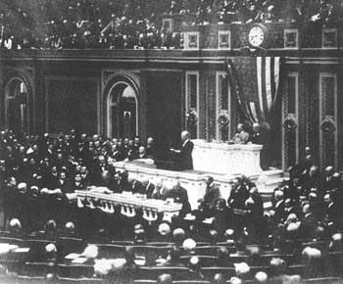
The Decision for War
  Americans outraged by Zimmerman telegram
  Wilson authorizes merchant ships to be armed, but by March 21, six American ships sunk
  April 2, 1917 - Wilson asks Congress for Declaration of War vs. Germany to stop German militarism: “warfare against mankind” “The world must be made safe for democracy”
  League of Nations to “bring peace and safety to all nations and make the world itself at last free.”
https://www.milestonedocuments.com/documents/view/woodrow-wilson-joint-address-to-congress-leading-to-a-declaration-of-war-ag/

Slide 36
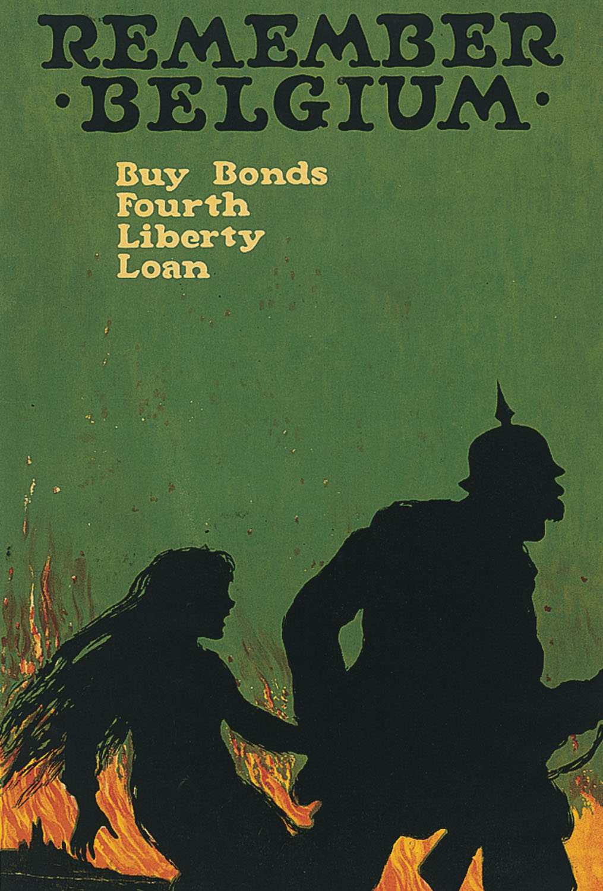
This poster by Ellsworth Young,
also from 1918, encouraged
Americans to buy Liberty
Bonds (that is, loan money to
the government) by emphasizing
the image of the vicious and
brutal Hun, part of a larger
process of demonizing the
people of the Central Powers.
http://www.pbs.org/wgbh/amex/wilson/gallery/p_war_06.html

Slide 37
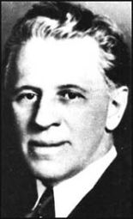
Mobilizing Public Opinion against “Huns”
Opponents to war: Some German-Americans, some Irish-Americans, Socialist Party, Wobblies (IWW), pacificists (Jeannette Rankin of MT)
Committee on Public Information (journalist and editor George Creel – Creel Committee) used posters, films, pamphlets, and news stories
Pro-Germans = “slackers” (TR called them “alien enemy”)
Americanization = rapid assimilation
Sauerkraut = “liberty cabbage”, Hamburger = “liberty sausage,” Frankfurters = “hot dogs,” burn German books, attack or lynch slackers
http://en.wikipedia.org/wiki/George_Creel

Slide 38
Civil liberties in time of war
  Espionage Act (1917) – crime to convey info or false info with intent to interfere with the operation or success of the U.S. armed forces OR to promote the success of their enemies
  $10,000 fine or 20 years
  Postmaster General can prevent objectionable material from circulating
  Sedition Act (1918) – amended Espionage Act – prohibited “any disloyal, profane, scurrilous, or abusive language about the form of government of the United States...or the flag of the United States, or the uniform of the Army or Navy” (repealed in 1920)
  S.C. upheld, and Civil Liberties Bureau formed

Slide 39

Germans in Michigan
80,000 German-born and 20,000 Austrian-born residents of Michigan
French and Spanish replace German as popular second-language
Berlin, Michigan became Marne, Michigan (named after 1914 French battle) in 1919
http://www.rootsweb.ancestry.com/~mipoh/ottawa.html

Slide 40

Michigan mobilizes for war
April 1917 – Organize state militia to replace the Michigan National Guard, and start a War Preparedness Board (WPB) with $5 million budget to supply the National Guard with shoes and blankets
The Bureau of Military Relief was created by the WPB to give comfort to servicemen during the war
https://seekingmichigan.org/look/2009/11/10/real-michigan-welcome

Slide 41

Michigan and the Draft
Gov. Albert Sleeper tried to win the votes of German-Americans in 1916, angering many voters. He also initially opposed the draft instituted by the federal gov’t.
Men age 18 – 45 in Michigan = 875,000 were eligible for service
115,000 were drafted, but 40% failed the physical, so physical education became a requirement in schools and colleges
http://en.wikipedia.org/wiki/Albert_Sleeper

Slide 42

Michigan’s Contribution to WWI
135,485 Michigan men (of 4 million Americans) including 46,000 volunteers
5,000 died (of 75,000 Americans), and 15,000 wounded
http://www.hal.state.mi.us/mhc/museum/explore/museums/hismus/1900-75/twenties/ww1/

Slide 43


Michigan National Guard
32nd (Red Arrow) Division went to France in early 1918 and fought on the front lines from May to November. It was the first allied division to pierce the German Hindenburg Line of defense.
The Red Arrow Division was made up of Wisconsin and Michigan National Guards, and fought in World War II.
http://mdo20.tripod.com/mi/mi_redarrow.jpg
http://www.32nd-division.org/history/ww1/32-ww1.html

Slide 44

Camp Custer
Housed and trained draftees in Battle Creek (3,000 buildings cost $10 million). 100,000 troops trained or demobilized there.
Spanish Flu Pandemic of 1918-1919 killed 674 at Camp Custer
Operated during WWI from Sept. 1917 – March 1919. Camp Custer was renamed Fort Custer and became a permanent military training base
In 1940, than 300,000 troops trained there during WWII, and 5,000 German prisoners were held there.
The Michigan National Guard still trains here
http://www.firstworldwar.com/photos/camplife.htm

Slide 45






Selfridge Field in Mount Clemens
http://en.wikipedia.org/wiki/Thomas_Selfridge
http://acepilots.com/wwi/us_rickenbacker.html
Land bought by Henry B. Joy of Packard Motor Car Company, and donated to federal gov’t
Nation’s first school of aerial gunnery (Eddie Rickenbacker trained here). Rickenbacker had 26 victories vs. the Red Baron’s 80.
It was named in honor of Lt Thomas E. Selfridge, the first military pilot of an aircraft driven engine who died in a powered air flight (piloted by Orville Wright in 1908)
Selfridge
http://acepilots.com/wwi/ger_richthofen.html
1908 Crash
http://en.wikipedia.org/wiki/Thomas_Selfridge
http://www.127wg.ang.af.mil/news/story.asp?id=123295151
http://en.wikipedia.org/wiki/107th_Fighter_Squadron
From 1971-1998, Selfridge ANGB was the largest and most complex joint Reserves Forces base in the United States. It is home to the Military Air Museum.
107th Fighter Squadron uses A-10 Thunderbolts

Slide 46
The Polar Bears
  President Wilson created the North Russian Expeditionary Forces, aka the Polar Bears. 5,500 U.S. troops went to fight the Red Army (the Bolsheviks) in Siberia in 1918-1919, to convince Russia to rejoin the war against Germany.
  75% of the 5,500 troops were part of Michigan Army National Guard trained at Camp Custer near Battle Creek.

Slide 47

http://antiqueshopsinmichigan.com/oakland/troy.htm

Slide 48
The Home Front – “Total War”
Mobilizing the Economy – direct federal control of the economy and industry, but business cooperated
  War Industries Board = Bernard Baruch led federal agency that coordinated production (production quotas, allocate raw materials, develop new industries, increase efficiency)
  Industrial production rose 20% sometimes under threat of gov’t takeover, but most voluntary
  Gov’t took over railroads, telephone, telegraph, shipbuilding

Slide 49
Mobilizing the Economy
  Daylight Saving Time – save fuel (coal) by extending daylight hours;
  National War Labor Board (NWLB) = advocated collective bargaining to resolve labor strikes (8 hour day and higher wages for no-strike pledge)
  Union membership increased 50% during war
  More women joined workforce in factories, offices, and stores (after war, men reclaimed factory jobs)
  U.S. Food Administration – Herbert Hoover urges Americans to conserve food for soldiers: Meatless Mondays, Wheatless Wednesdays, war gardens
  War was paid for by income taxes and the sale of Liberty Bonds (Liberty Loans = 4 bond issues)

Slide 50

Michigan Farmers aid war effort
25% increase in food production in 1917 as the WPB buys additional seed, but labor shortage occurred
WPB sold 1,000 Ford tractors to farmers at cost
At harvest time, schools closed so children, college students, and women could help
http://www.antiquefarming.com/farm-tractor.html

Slide 51


Liberty Loans
Estimated 25% of Michigan residents bought liberty bonds or liberty stamps during four “Liberty Loan drives.” Local newspaper sometimes published names of people who didn’t contribute
http://docsouth.unc.edu/wwi/41880/menu.html
http://docsouth.unc.edu/wwi/41931/100.html

Slide 52
Michigan and World War I
In U.P., people used wood instead of coal
Store hours limited; churches only could be heated for six hours a week
Iron and Copper production at record highs
Steel ships built in Saginaw, Wyandotte, Ecorse
Civilian car production greatly reduced, and Packard and Reo made armored trucks
Packard, Buick, Cadillac, Ford, and Lincoln (under former Cadillac head Henry Leland) made the Liberty airplane engine
Ford’s new River Rouge plant produced a few Eagle boats (“submarine chasers”)

Slide 53






http://corporate.ford.com/our-company/heritage/company-milestones-news-detail/681-eagle-boats
Ford’s first product from the Rouge Plant was the Eagle Boat, a 110’ “submarine chaser.” Ford only produced 60 boats, and they never saw service in WWI, but a few were used in WWII. Ford also built thousands of Model T ambulances, and a few tanks.
6 , 8, and 12-cylinder airplane engines were called “Liberty engine.” By the end of the war, Detroit produced 13,574 Liberty engines, attaining a production rate of 150 engines per day
http://en.wikipedia.org/wiki/USS_Eagle_Boat_56_(PE-56)
http://en.wikipedia.org/wiki/List_of_U.S._military_vehicles_by_supply_catalog_designation
http://en.wikisource.org/wiki/A_Concise_History_of_the_U.S._Air_Force/Trial_and_Error_in_World_War_I
Dodge made a light repair truck
9,500 Liberty trucks were produced by 15 manufacturers. The 3-5 ton truck had a 52 hp engine capable of 15 mph.
Model T ambulance
http://www.oldwoodies.com/gallery-truckwoodies1.htm
http://en.wikipedia.org/wiki/Liberty_truck

Slide 54
Henry Ford and World War I
Ford was initially a pacificist, and denied that his company would ever produce any war materials. James Couzens quit over disagreement with Ford’s pacifist views.
November 1915 peace mission failed, but he supported ($60,000 in newspaper ads) Democrat Woodrow Wilson in 1916, who promised to keep America out of war
Democrat Ford ran for vacated Senate seat against Republican Truman Newberry, but Newberry won by less than 5,000 votes in the “most celebrated and controversial” election in Michigan’s history. Ford, who did no campaigning, called for a recount, but to no avail. Republicans now had control of the U.S. Senate, and later vetoed American entry into to President Wilson’s League of Nations.
Newberry, accused by Ford of exceeding the $10,000 spending limit, was not seated until January 1922 (38 months after election) after the Supreme Court overruled a federal grand jury.

Slide 55

The SPANISH FLU HITS MICHIGAN 1918-19
Perhaps 50 million people died worldwide (675,000 in the U.S.) Killed more young than old. Killed more people in one year than the WWI (16 million) and the Bubonic Plague in Europe did in four years (1347-1351)
“Flu villages” made of tents kept the sick isolated and outdoors because fresh air and sunshine were believed to kill the virus. “No spitting” signs became standard
Victims sometimes died within 24 hours of first symptoms, usually a minor cough
Peaked in fall 1918, and by Nov. 1918, Michigan had 789 new cases. State Dept. of Health closed all theaters, churches, pool halls, and schools, and banned public gatherings
By summer 1919, flu was largely gone
Famous victims: John and Horace Dodge

Slide 56




Postwar “Dry” Michigan
http://www.ediblegeography.com/spaces-of-prohibition/
  1896 – Anti-Saloon League branch organized in Michigan. Anti-Saloon League persuaded Congress to pass temporary national prohibition in 1917 to aid the war effort.
  1907 - Van Buren is the only remaining dry county (first one in 1887)
  1911 – ½ of Michigan counties are dry. Anti-Saloon League (and Henry Ford) emphasized lost worker productivity rather than moral issue.
  May 1, 1918 – Michigan voted itself dry, the first state to do so (almost 2 years before the 18th Amendment) BUT IT WAS NOT THE FIRST STATE TO RATIFY THE 18th AMENDMENT (Mississippi - Jan. 1918).
Preacher Billy Sunday was the most vocal supporter
http://en.wikipedia.org/wiki/Billy_Sunday
http://www.wpl.lib.oh.us/AntiSaloon/
Westerville, OH, once called the “Dry Capital of the World,” was the home of the Anti-Saloon League. Westerville was dry until 2006.
http://www.waymarking.com/waymarks/WM1DPH_The_Anti_Saloon_League_Headquarters_Westerville_Ohio

Slide 57




GERMAN BREWERS FIGHT PROHIBITION
Brewers ran ads extolling the benefits of beer for children and adults, such as:
http://lunapancake.tumblr.com/post/11886026153/jsinghurse-george-h-gies-against-prohibition
http://lunapancake.tumblr.com/post/11886026153/jsinghurse-george-h-gies-against-prohibition
http://lunapancake.tumblr.com/post/11886026153/jsinghurse-george-h-gies-against-prohibition
http://pastperfect-online.tumblr.com/post/40602153912/prohibition
“Lagers amber fluid mild, gives health and strength to wife and child.”
“The youngster, ruddy with good cheer, serenely sips his Lager Beer.”
“Refreshing beer gives strength and health, and smooths away the rugged road to wealth.”
“In robust age with wealth and friends, enjoying beer, his days he spends.”

Slide 58

Prohibition in Michigan (Jan. 1920)
“Blind pigs” (“speakeasies”) = illegal drinking establishments, frequently with gambling
Detroit got alcohol legally from Ohio until 1920.
Detroit became center of smuggling from Canada. 75% of all illegal alcohol to the U.S. came through the “Windsor-Detroit Funnel.”
April 10, 1933 – Michigan was first state to repeal prohibition, but created the Liquor Control Commission
Some Michigan cities prohibited alcohol sales by the glass as late as 1960.
The term “Blind pig” may come from the practice of charging an entry fee to see something unusual, like a blind pig, and then serving “free” alcohol. “Speakeasy” came from speaking quietly when ordering.
http://www.reuther.wayne.edu/node/8278

Slide 59
The terminology of prohibition
Beerocrat = person who make a fortune selling beer
Bootlegger = person who sold liquor illegally, perhaps by hiding liquor in his boot legs
Bleary-eyed, corked, embalmed, loaded for bear, pull a Daniel Boone, Three sheets in the wind = Drunk
Barrel house, Boozery, Dive, Doggery, Gin Mill, Jimmy, Joint, Rumhole, Schooner, Shoe Polish Shop = Saloon
Apple Jack, Bingo, Blue Pig, Blue Ruin, Demon Rum, Hooch, Jackass Brandy, Juniper Juice, Monkey Swill, Moonshine, Mule, Panther Sweat, Red Eye, Rye Sap, Shoe Polish, Squirrel, White Coffee, White Lightning = Liquors

Slide 60

The Purple Gang (1927-1932)
http://1920s-style.tumblr.com/
Jewish bootleggers (4 brothers in the Bernstein family) based in Detroit, guilty of hijacking, extortion, kidnapping, and murder. Controlled prostitution, gambling, liquor and drug trade. Sold Canadian whiskey to the Capone family in Chicago.
Rumrunners – people with fast boats across the Detroit River to Canada
Hijacking – steal shipment of illegal booze from rumrunner by killing everyone

Slide 61

The Purple Gang - 1929
http://www.j-grit.com/criminals-the-purple-gang.php
Jail sentences and in-fighting ended the reign of the Purple Gang prior to repeal of 18th Amendment in 1933. Four members were sentenced to jail after the Collingwood Manor Massacre in 1931 where three Chicago mobsters were killed.

Slide 62
19th Amendment and Women’s rights
1860s – women worked as school teachers or domestic servants
1867 – Women taxpayers allowed to vote in school elections
1870 – Michigan Suffrage Association formed
1884 – Michigan Equal Suffrage Association
1893 – State Supreme Court overturns laws allowing women to vote in municipal elections
Voters in Michigan feared women voters would favor Prohibition
November 5, 1918 (6 months after Prohibition) – women allowed to vote (nationally, 19th Amendment adopted in 1920)

Slide 63
The KKK in the 1920s
Ku Klux Klan originally started in 1860s, but reborn with 1915 movie Birth of a Nation, with the center in Indiana, Ohio, and Illinois.
70,000 KKK members in Michigan
Klan-supported mayoral candidate in Detroit Charles Bowles almost won as a write-in candidate in 1924.
Judson Transue, with KKK support, became mayor of Flint
KKK was weak by 1928, and gone by 1934

Slide 64
The Great Migration and White Reaction
1910-1920- Massive movement from South to North (many blacks) mainly to industrial cities in the North
“Push” = lynchings, hard life in agriculture
“Pull” = huge need for factory workers, better jobs, higher pay, less racism
Race riots in many cities (worst was St. Louis – 39 died) due to housing, job discrimination, segregation
Rebirth of the KKK in the Midwest (Southern whites move north seeking jobs)
Michigan finally becomes 50% urban, 50% rural between 1910-1920. Michigan became urban later than neighboring states and cities such as Buffalo and Cleveland. Auto industry shift population from northern 2/3 of state to southern 1/3. Michigan population grew 32% between 1910 and 1920.

Slide 65
Black Migration to Detroit
1910 – 5,741 blacks (1.2%)
1920 – 40,838 blacks (4%) (Gen. Pop. grew 113%)
1930 – 120,000 blacks (7.6%) (Gen. pop. grew 58%)
1940 – 149,000 blacks (9%) (Gen. pop. grew 3.5%)
1950 – 300,000 (16%) (Gen. pop. grew 14%)
1960 - 482,000 (29%) (Gen. pop. shrank 10%)
1970 – 660,000 (44%) (Gen pop. shrank 10%)
1980 – 759,000 (63%) (Gen. pop. shrank 20%)
1990 – 778,000 (76%) (Gen. pop. shrank 15%)
2000 – 776,000 (82%) (Gen. pop. shrank 7.5%)
2010 - 590,226 (83%) (Gen. pop. shrank 25%)

Slide 66
Anxiety after the Great War
4 million Americans rejoined workforce, compete for jobs (unemployment rose to 12%)
Blacks have moved north into white areas
HCL (High Cost of Living = inflation) prices doubled 1913-1919
Strikes (workers want wages to keep pace with inflation) U.S. Steel – Feds send troops to quell (18 killed)
Anarchists mail bombs, plant bombs
Red Scare – fear of subversion by Bolsheviks, radical Socialists and anarchists

Slide 67
Red Scare (1919-1920)
  Palmer Raids (1919) = Atty. Gen. A. Mitchell Palmer orders arrest of 5,000 suspected radicals and Bolshevik sympathizers. Raids were largely unsuccessful, but deported several hundred radicals. Palmer also appoints J. Edgar Hoover to head anti-radical unit of the Bureau of Investigation (precursor of the FBI). Hoover led FBI for 48 years starting in 1924.
  Jan. 2, 1920 – 800 arrested in Detroit , confined for several days, but freed because no evidence could be found
  Red Scare died down as general strikes didn’t occur and people denounced NY’s expulsion of five Socialists from the state legislature.

Slide 68

Alex Groesbeck (Republican) 1921-26
Attorney General in 1916 and 1918 under Gov. Sleeper and acted as a “muckraker”
Became Governor in 1921, and created the State Administrative Board to coordinate the over 100 departments, bureaus, commissions and agencies. 3 functions:
1.) create a budget
2.) Centralize purchasing
3.) Uniform accounting
4.) Governor can veto Board’s decisions
Tough, dictatorial bachelor was a great administrator, and he was reelected in 1922 and 1924, but was defeated for a fourth term in 1926 by Fred W. Green
http://records.ancestry.com/Braden_Alex_Groesbeck_records.ashx?pid=157610245

Slide 69
James Couzens
http://en.wikipedia.org/wiki/James_J._Couzens
Business manager of the Ford Motor Company from 1906 to 1915. He invested $2,500 in 1902, and Ford bought him out in 1919 for $30 million.
Democratic-leaning Republican served as Detroit Police commissioner and mayor of Detroit 1919-1922
As Detroit mayor, he broke up the streetcar monopoly, and created the Department of Street Railways.
Appointed to U.S. Senate by Gov. Groesbeck, serving from 1922 until his death in 1936.
Refused to endorse Calvin Coolidge for president in 1924.
Fought with Coolidge’s Treasury Secretary Andrew Mellon over raising income tax rates on the rich, so Mellon sued Couzens for underpayment of taxes on his sale of Ford stock. Couzens won, and donated $10 million to charity.

Slide 70
The development of roads
Bicycles became popular in the 1880s, and bicycle clubs, like the League of American Wheelmen under Horatio Earle, demanded better roads. Earle later became the first state highway commissioner in 1905.
1905 – 68,000 miles of public dirt roads, and only 245 miles of macadam roads. Road tax was insufficient
1905 – Motor vehicle license fees start funding road construction, but only 3,000 cars
1912 – Congress authorizes $10,000 to each state to develop “post roads” used for rural mail delivery
1913 – State authorizes 3,000 mile trunkline network
1916 – Federal Road Aid Act ($75 million over 5 years)
1921 – Federal Highway Act (create interstate highway) - $81 billion
1924 – Federal aid and $50 million in bond money built 1,195 miles of concrete highway (Michigan was first state to use bypasses)
1925 - $.02 gas tax to pay for highway (one of the first “user fees” in MI)

Slide 71

Motorbuses and Motor trucks
1920s – replace trains and the interurban
1923 – State starts regulation of buses
1929 – 164 companies and 1,500 buses
Motor trucks replace railroads
Car, trucks, and buses transformed rural communities, and brought them closer to cities
http://www.detroittransithistory.info/Routes/JohnRNorth.html

Slide 72


Telephone, Radio
http://earlyradiohistory.us/1910mrg.htm
1920 – 50% of farms had telephones
Radio – Thomas “Wireless” Clark pioneered wireless telegraphy (Morse Code)
WWJ in Detroit becomes second broadcasting station in the U.S. in 1920 (first was KDKA in Pittsburgh)
http://assolingue.com/blog.php?258d9ce8679fd14016c93de9452b9f8d

Slide 73




Agricultural Machinery
http://www.corbisimages.com/stock-photo/rights-managed/IH170859/horsedrawn-combine-thresher
1879 – Binder binds cut grain into sheaves (called reaping)
1881 - Threshing machine separates grains from stalks and husks
1920s – Tractor replaces horses, pulls combine
1940 – Combines do reaping, threshing, and winnowing (separate grain from chaff)
http://en.wikipedia.org/wiki/Mechanised_agriculture
http://en.wikipedia.org/wiki/Fordson_tractor
http://en.wikipedia.org/wiki/Combine_harvester

Slide 74

Electricity
1885 – James McMillan has first residence in Detroit with electric lighting
Prior to 1920 – basement generators (8% of farms had electricity)
1920 -1950 – lines from central power plant (96.6% of farms had electricity)
Thomas Edison, the “Wizard of Menlo Park,” had over 1,000 inventions. He grew up in Port Huron, but spent most of his life in Menlo Park, NJ. His company, which merged in 1892 to become General Electric was, and still is, one of the world’s largest corporations.
http://contributionstoscience.wikispaces.com/Thomas+Edison+and+the+Lightbulb

Slide 75

Michigan Agriculture
Wheat was leading crop until 1900 (now one of the leading growers of winter wheat for pastries and breakfast foods)
Corn is an another important crop
Wool from sheep was a important in 1800s
Pigs and hogs became more important in 20th century
Increased specialization in profitable crops like potatoes, dry beans, sugar beets, fruit
Increased scientific knowledge – “Farmer Institutes” (MAC professor Dr. Robert Kedzie) and “experiment stations” produce better strains, fertilizers, and pesticides
http://www.hal.state.mi.us/mhc/museum/explore/museums/hismus/1900-75/erlyagri/images/agmap2.gif

Slide 76
The Decline of Agriculture
1870 – Michigan Horticultural Society
1919 – Michigan State Farm Bureau established to regulate, tax, and advocate for farmers (Farm Bureau Insurance in 1928)
1850 – 85% of Michiganders relied on agriculture
1950 – Less than 5%
1910 – Peak # of farms = 207,000 (now 56,000)

Slide 77
Iron MINING, Copper Mining, and Oil
Prices and production reached highs prior to and during World War I, but declined significantly during the Depression.
Prices rose during WWII, but dropped off so both iron and copper mining largely ended.
Oil was discovered in Saginaw in 1925
1928 – Discovery Well made Mt. Pleasant the center of Michigan Petroleum industry.
Michigan still produces a significant amount of oil and natural gas

Slide 78

Chrysler Corporation
Walter P. Chrysler left General Motors over dispute with Billy Durant, and was put in charge of two automakers, Maxwell and Chalmers. He quickly made them profitable.
1925 – founded Chrysler Corporation
1928 – merged with Dodge Brothers, who had the best dealer network
http://kids.britannica.com/comptons/art-139445/Walter-P-Chrysler

Slide 79

Alfred P. Sloan, Jr.
Head of GM after death of Billy Durant
With market saturated, Sloan recommended annual model changes, making GM the market leader by the late 1920s.
/http://www.nndb.com/people/631/000117280

Slide 80


Cadillac place (the GM building)
Started in 1919, and completed in 1923
Was originally called the Durant Building, but Durant was ousted in 1921, so renamed the General Motors Building
Was world’s 2nd largest office building
Served as GM’s world headquarters from 1923 to 2001 when moved to the Ren Cen
Now leased by the State of Michigan for 20 years, and renamed Cadillac Place
http://en.wikipedia.org/wiki/Cadillac_Place
http://detroit1701.org/General%20Motors%20Building.html

Slide 81

Edsel Ford
http://en.wikipedia.org/wiki/Edsel_Ford
1927 – Ford discontinues Model T due to competition from Chevrolet, then makes Model A
GM remained leader, followed by Ford, followed by Chrysler (called the Big Three)
Flint becomes GM town, with huge Buick and Chevrolet plants, and AC Spark Plug and Fisher Body plants.
Saginaw had Chevrolet plant, Lansing produced Reos and Oldsmobiles

Slide 82

Poles in Hamtramck
http://www.hamtramckstar.com/america_automobile_workers_1900_1933/
Polish were most numerous of the new Europeans, replacing the Irish and Germans of the 19th century
1871 – First Polish Catholic church, St. Albertus, in Detroit
1915 – 80% of Hamtramck population is Polish, thanks to Dodge Brothers plant
1930 – Over 66,000 Poles in Detroit (followed by 28,581 Italians)
1973 – Detroit has the largest Arabic-speaking community in North America

Slide 83








Detroit’s Building Boom
http://en.wikipedia.org/wiki/Penobscot_Building
http://en.wikipedia.org/wiki/Hammond_Building
At 10 stories tall, the Hammond Building was Detroit’s first skyscraper in 1889. George Hammond pioneered refrigerated railroad cars. Located at Fort and Griswold, it was torn down in 1956.
When completed in 1928, the 47-story Penobscot Building was the world's eighth tallest building. It was the city's tallest from 1928 to 1977.
At 19 stories tall, the Ford Building was Detroit’s tallest building from 1909 to 1913.
All images: Wikipedia
In the 1920s, several Detroit buildings were constructed: Buhl, Guardian, Fisher, Book Tower, and Book Cadillac Hotel.
http://en.wikipedia.org/wiki/Ford_Building_(Detroit)

Slide 84
Migration to Michigan
In 1924, the National Origins Act limited foreign immigration
Before 1924, few Southerners came to MI
By 1930, Michigan had 165,000 whites born in the South
Movement of blacks and white southerners to Michigan during WWI caused tensions (segregated housing, schools, parks)

Slide 85




Bath School Disaster
May 18, 1927 at 8:45 AM
http://www.todayifoundout.com/wp-content/uploads/2012/05/bath-school.jpg
http://en.wikipedia.org/wiki/Andrew_Kehoe
Andrew Kehoe, the 55-year-old school board treasurer, was angry after his defeat in the spring 1926 election for township clerk. His wife was ill,
and he was in danger of losing his 80-acre farm due to a school tax he fought against.
Kehoe first killed his wife, fire-bombed his farm as a diversion, and dynamited the Bath Consolidated School (only 300 residents in whole town) that killed 37 elementary school children, 1 teacher, and injured 58 more people.
http://www.csmonitor.com/Books/chapter-and-verse/2012/0724/America-s-deadliest-school-violence-Not-Columbine-but-Bath-Mich.-in-1927
He then committed suicide by detonating a final explosion in his truck, which killed the school superintendent and several others.
It is the deadliest mass murder in a school in United States history. 45 people died, including 38 children. By comparison, 28 people were killed in the Newtown, CT killing in 2012.
http://www.flickr.com/photos/92726077@N00/3502827714/

Slide 86


The Curious Case of Dr. Ossian Sweet
Dr. Sweet (and 9 other men) defended his home in Detroit from a white mob in 1925. A stone broke the upstairs window. Shots were fired from the house (from guns purchased by Sweet), killing a white man. Defending himself in court but with help from the NAACP and Clarence Darrow, an all-white jury acquitted him of murder. Judge Frank Murphy presided. Years later and financially destitute, Sweet killed himself in 1960.
"I have to die like a man or live a coward."
http://en.wikipedia.org/wiki/Ossian_Sweet
http://en.wikipedia.org/wiki/Ossian_Sweet

Slide 87
Negro Leagues
No blacks allowed in MLB from 1887 to 1947
First Negro professional team was the Cuban Giants in 1885. Last Negro League season was 1960.
Rube Foster was the “Father of Black Baseball”
Negro League teams in Detroit from 1894 to 1960 (Stars, Giants, Wolves, Senators, Black Sox, and Clowns)
Most famous was the Detroit Stars in the Negro National League from 1920 to 1930 (490-384, .561)
Norman “Turkey” Stearnes (1923-1930) was one of the greatest Negro League players (.353 lifetime)
Last team to integrate: the Boston Red Sox in 1959
Detroit Tigers were second to last: Ozzie Virgil in 1958 (Walter “no Jiggs with” Briggs owned the team)

Slide 88


Turkey stearnes and the stars
Detroit Stars played in the Negro National Leagues from 1919-1931. Most of their games were at Mack Park.
Outfielder Norman “Turkey” Stearnes was their best player. Elected to the Baseball Hall of Fame in 2000. Worked at Tigers owner Walter (“No Jiggs for Briggs”) Briggs’ auto factory in the offseason.
First black player in MLB was Jackie Robinson in 1947. First black Tiger was Ozzie Virgil (also first Dominican in MLB) in 1958. Virgil was 5-for-5 that day.
http://en.wikipedia.org/wiki/Turkey_Stearnes
“I never counted my home runs. I hit so many, I never counted them, and I'll tell you why: If they didn't win a ball game, they didn't amount to anything.”
http://www.baseball-reference.com/players/v/virgioz01.shtml

Slide 89
Detroit and Automobiles
  Symbol of consumer-oriented economy of 1920s
  Ford’s Model T (“Tin Lizzies”) cost only $290 in 1927 ($3,400 today) (15 million made)
  Ford workers were paid very well, but weren’t allowed to talk, sit, smoke, sing or whistle while performing very repetitive tasks.
  GM (1908) and Chrysler (1925) cars had more style and comfort than Model T. Ford introduced Model A in 1928 to compete. GM started introducing new models every year.
  80% of the world’s cars were in the U.S., and the Big Three made 83% of all cars. 5 million cars made in 1929.
  2/3 of cars sold on credit
Model A’s on the assembly line in 1928. The line moved at a rate of 6 feet per minute.
http://www.canoelover.com/?attachment_id=1091

Slide 90


Ford Rouge Plant
After 11 years of construction, it was the world’s largest industrial complex in 1928 with 16 million square feet of factory floor space (3X the size of the Ren Cen)
Albert Kahn designed some of the 93 buildings, housing over 100,000 workers
http://en.wikipedia.org/wiki/File:River_Rouge_aerial_4a25915r.jpg
http://www.semiwiki.com/forum/content/671-apple-strength-will-compel-arm-trim-its-sails.html

Slide 91
How the Automobile Changed Everything
  Profoundly changed patterns of living
  Promoted movement to cities
  Tractors allowed more agricultural productivity
  Growth of Suburbs, single family houses
  Traffic Lights (first one in Detroit in 1920)
  Personal mobility made the youth less dependent on their parents, and wives less dependent on men
Los Angeles: Automobile Metropolis (population went from 100,000 in 1900 to 2.2 million in 1930) 1 car for every 3 residents, first supermarket, shopping district designed for cars

