Slide 1
Industrial detroit
1860-1900

Slide 2
Detroit becomes a boomtown
1860 – 45,619 residents
1870 – 79,603 (75% increase)
1880 – 116,340 (46% increase)
1890 – 205,876 (77% increase) (15th largest city in U.S.)
1900 - 285,704 (39% increase) (13th largest city in U.S.) Nearly 12% don’t speak English, the highest percentage in the U.S.

Slide 3
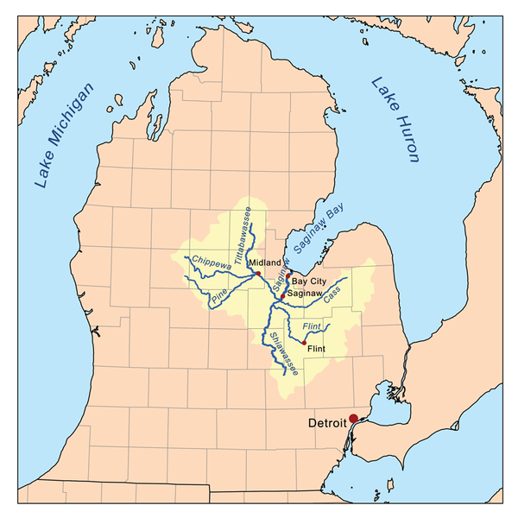
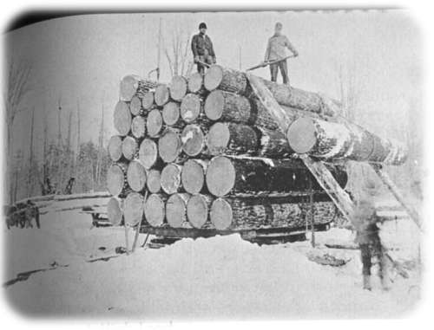
Lumbering – Michigan’s First Great Industry (“Green Gold”)
White Pine was most valuable tree
Saginaw Valley was first center of lumber production
Cut close to rivers to float logs to sawmill
1834 – First steam sawmill in Saginaw Valley used the engine from the Walk-In-The-Water
During 1860’s, Michigan became #1 and remained until turn of the century. Many lumbermen from Maine moved to Michigan
Around 1880, Michigan produced 25% of all lumber in the U.S., and lumber production began in the Upper Peninsula, which was largely inaccessible without navigable rivers.
By 1900, most virgin timber was gone, so the timber industry moved to the Pacific Northwest
http://bay-journal.com/bay/1he/writings/mi-lumbering-1868.html
https://www.facebook.com/pages/Saginaw-River/142895532388133?nr

Slide 4
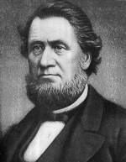
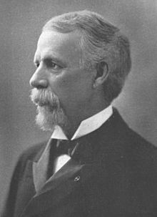
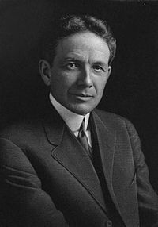
LUMBER BARONS
http://en.wikipedia.org/wiki/Henry_H._Crapo
Henry Crapo created the largest privately-owned business in Michigan through vertical integration (owned timber and the finished product). Built the Flint and Holly Railroad.
Mayor of Flint 1860, Michigan Senator in 1862, Governor 1865-1869
A colonel for the Fifth Michigan Cavalry in the Civil War, Russell Alger made millions in lumber in Grand Rapids. He was governor from 1885-1887, and the Secretary of War under Pres. McKinley 1897-1901.
Crapo’s grandson was William Durant, who used his expertise in selling wooden carriages in the late 1800s to create General Motors in 1908.
http://en.wikipedia.org/wiki/Russell_A._Alger
http://en.wikipedia.org/wiki/William_C._Durant

Slide 5
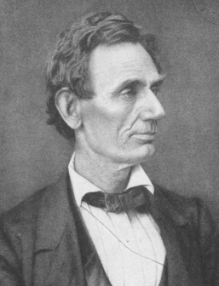
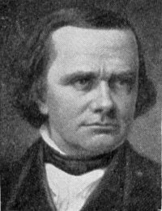
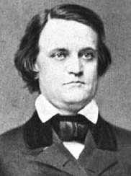
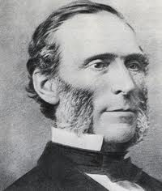
Election of 1860
http://en.wikipedia.org/wiki/File:AbrahamLincoln.png
http://en.wikipedia.org/wiki/File:AbrahamLincoln.png
http://www.russpickett.com/ushist/usvpres2.htm
Republican Abe Lincoln vs. (Northern) Democrat Stephen Douglas vs. (Southern) Democrat John C. Breckinridge
Seward campaigned in Michigan on Lincoln’s behalf, and Douglas visited
Lincoln won (88,445 votes) over Douglas (64,958)
Republican Austin Blair defeated Democrat John Barry for the governor. He won reelection by a narrow margin in 1862.
http://hd.housedivided.dickinson.edu/node/32269

Slide 6
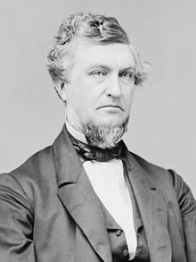
The South secedes
Before Lincoln was inaugurated, South Carolina seceded on Dec. 20, 1860. Seven other states followed.
Leading Republicans in Michigan (Sen. Chandler and Gov. Blair) opposed secession
South seized most federal forts, navy yards, and custom houses
Lincoln tried to re-supply Fort Sumter in Charleston, South Carolina, where the soldiers would not surrender, so South Carolina fired on them on April 12, 1861
Zachariah Chandler: “Without a little bloodletting, this Union will not, in my estimation, be worth a rush.”
http://www.answers.com/topic/zachariah-chandler

Slide 7
“Thank God for Michigan!”
Feds request one regiment (10 companies). Michigan had 28 companies in their militia, which was a social and military organization. Locally funded, because state spent less than $3,000 on militia.
No money in state treasury to train, equip, house, clothe, or feed volunteers
Private donations of $81,000 came in (to be repaid by the state.
Detroit Light Guard was Company A
Col. Orlando Willcox was commander of the First Michigan Infantry Regiment
Regiment (798 men) assembled on April 29 at Fort Wayne
Took a ship to Cleveland, then the railroad to Washington DC (first regiment for the Western states to arrive on May 16, so Lincoln said, “Thank God for Michigan!”
Many Northerners assumed a show of force was all that was needed

Slide 8
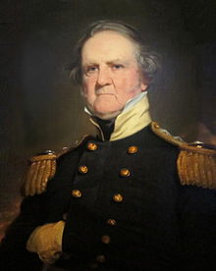
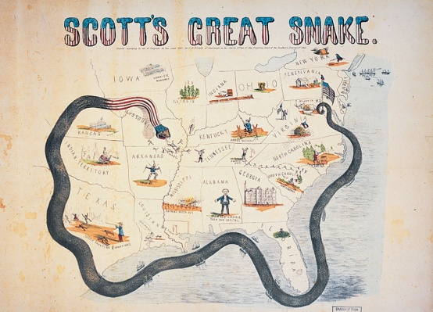
Michigan’s Infantry Regiments
First Michigan Infantry Regiment occupied Alexandria, VA, with little resistance.
Second Michigan Infantry Regiment (mostly West Michigan men) formed on April 25 under Adjutant General Robertson
Lincoln called for 42,000 more volunteers and a three year term
Third and Fourth Regiments formed and arrived in Washington by June 25
General Winfield Scott, a veteran of the War of 1812, was the highest ranking military officer for the North
http://en.wikipedia.org/wiki/Winfield_Scott
Scott retired at the end of 1861, but his “Anaconda plan” to suffocate the South by controlling the Mississippi River continued
http://en.wikipedia.org/wiki/Anaconda_Plan

Slide 9
The Battle of Bull Run – July 21, 1861
First Michigan fought (6 killed, 37 wounded, 70 captured or missing) in Manassas, VA. Col. Willcox was wounded and taken prisoner. Second and Third Michigan covered the retreat.
War would not be brief
End of 3 month enlistment period, so many men in the First Michigan returned to civilian life, and only a few reenlisted

Slide 10
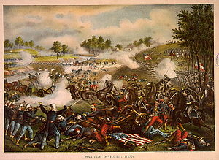
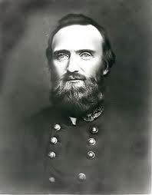
The battle of bull run was the first major battle of the Civil War. The South won, and Col. Thomas Jackson, earned his nickname “Stonewall” Jackson. The Union lost 460 soldiers; the South 387.
http://en.wikipedia.org/wiki/First_Battle_of_Bull_Run
http://www.sonofthesouth.net/leefoundation/Stonewall_Jackson.htm
Jackson died of complications from pneumonia on May 10, 1863

Slide 11
Michigan’s contribution
90,000 men served in the Union army and navy (23% of total male population)
31 infantry regiments, 11 cavalry regiments, 1 regiments of mechanics and engineers, 14 artillery batteries, 1 regiment of sharpshooters, and several miscellaneous units. 500 men in the navy.
Blacks and Jews served in disproportionate numbers
First Michigan Colored Infantry Regiment served in early 1864, but was ridiculed by Detroit Free Press, who called them the “First Ethiopians.”
Few Indians enlisted, and whites feared they could not adapt to “civilized” warfare

Slide 12
Recruitment
Much social pressure to enlist. Political figures used to command units.
Most fought to save the Union, not free blacks
Raised local taxes to give $15 per month to families without head of household.
Federal, state, and local gov’ts paid “bounties” for volunteers, but some men deserted after getting bounty
Aug. 1862 – Draft instituted by presidential order
March 1863 – Congress declares a draft, but only 4,281 Michigan men served this way
Wealthy people could pay $300 fee to get out of service, or hire someone to go in their place.

Slide 13
War and Disease
Almost 15,000 died (1 of 6 that served)
Twice as many died of disease as in action except for officers who died more in battle
Sixth Michigan Infantry had only 78 of 582 deaths from battle

Slide 14
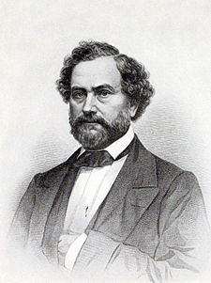
Deadly New Weapons
http://en.wikipedia.org/wiki/Samuel_Colt
Rifled muskets (Springfield rifles) were more accurate and could shoot up to 1,000 yards, but 400 yards accurately.
Samuel Colt invented waterproof cartridges which misfired less and reloaded quicker.
Colt also invented the 6 shooter pistol
Exploding artillery shells
Surgeons could only amputate
8% of all white males from 13-43 died
First photographed war
Colt was the first man to successfully employ the assembly line due to his use of interchangeable parts.

Slide 15
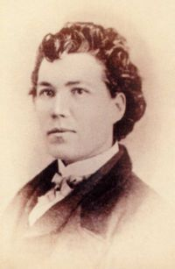
A soldier’s life
Life as a soldier was hard, with long marches, bad food, bad weather, lots of drilling
Sarah Emma Edmonds masqueraded as a man (named Frank Thompson) to fight for the Second Michigan Infantry
http://en.wikipedia.org/wiki/Sarah_Emma_Edmonds

Slide 16
Life during the war
Michigan state song “Michigan, My Michigan” was created during the Civil War to the tune of “O Tannenbaum”
Labor shortage in many communities
Demand for labor-saving farm machinery like reapers and mowers. Women worked in fields. Farm prices rose.
Lumber market was saturated, so logging industry did not prosper during the war
Michigan Soldiers’ Relief Association – 1862 State effort to raise money of families of injured veterans, and send supplies to soldiers in the field.
Michigan Soup House – hostel in Washington that supplied food and shelter for soldiers on leave

Slide 17
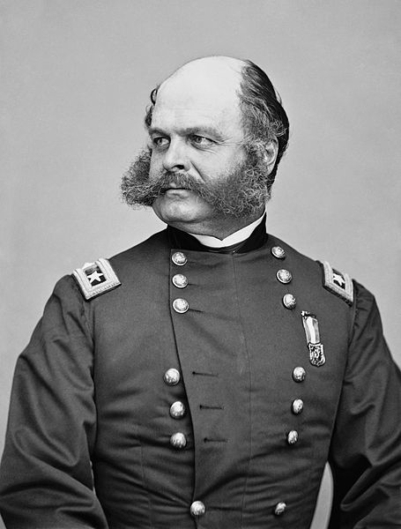
Lee’s Invasion of Maryland and the Battle of Antietam
Lee invaded the North in Maryland by splitting into three groups. McClellan found Lee’s plans in an abandoned camp but failed to act quickly to benefit from it.
Antietam – McClellan vs. Lee in the bloodiest single day battle of the CW. Largely a draw, but Lee retreated, suffering his first defeat.
Stonewall Jackson covered Lee’s retreat, and soundly defeated McClellan’s pursuing troops.
Lincoln was still disappointed with McClellan, who was fired, and replaced with Gen. Ambrose Burnside.
Sideburns were named for Ambrose Burnside
http://en.wikipedia.org/wiki/Ambrose_Burnside

Slide 18
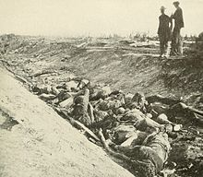
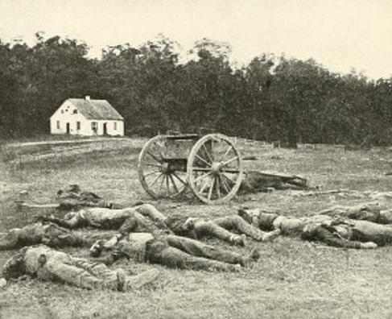
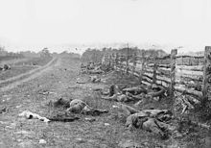
Antietam (Sept. 17, 1862)
http://scienceviews.com/parks/dunkerchurch.html
http://danvillevthistorical.org/?p=1695
http://en.wikipedia.org/wiki/Battle_of_Antietam
The Union had 12,401 casualties with 2,108 dead. Confederate casualties were 10,318 with 1,546 dead. This represented 25% of the Union forces and 31% of the Confederate forces. Lincoln believed that McClellan's cautious and poorly coordinated actions in the field had forced the battle to a draw rather than a crippling Confederate defeat. Still, Antietam was a “turning point” and the first major Union victory and was followed by the Emancipation Proclamation on September 22.

Slide 19
Lincoln and the Politics of Emancipation
Lincoln got pressure from Radical Republicans to free the slaves
Boost support for the war in the North
Boost international support for the war
Get blacks to enlist in Union Army
Get slaves to revolt against masters
Lincoln waited until after “victory” at Antietam so as not to seem desperate to make announcement
On September 22, 1862, Lincoln issued a preliminary proclamation that he would order the emancipation of all slaves in any state of the Confederate States of America that did not return to Union control by January 1, 1863. None did, so the Executive order took effect on January 1, 1863.

Slide 20
The Emancipation Proclamation
Freed no slaves, because it applied only to areas controlled by the Confederacy (3.1 million of the 4 million slaves), not the 4 slave states that fought for the Union (KY, MO, WV, MD)
Freedom for blacks was dependent on a Union victory in the Civil War. MADE ENDING SLAVERY A SPECIFIC WAR AIM. Before, the war aim was to preserve the Union.
Most people celebrated the announcement
Critics derided the fact that it did not apply to free slaves in areas the Union controlled: “an absurd proclamation by a political coward.”
Some opposed fighting for black freedom

Slide 21
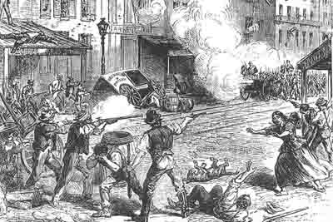
1863 Race Riot in Detroit
“the bloodiest day that ever dawned upon Detroit”
Mexican-American tavern owner named William Faulkner was accused of raping two white 9-year old girls. He was sentenced to life in prison, but a white mob harassed Faulkner and prison guards, who shot and killed a white bystander, sparking a riot
2 dead (one black), many injured, 35 buildings burned in span of about 6 hours. Blacks fled to Canada
Full-time police force created after riot in 1865
Girls later said they weren’t raped, and Faulkner was released
http://notnowsilly.blogspot.com/2012/07/the-detroit-riots-unpacking-my-detroit.html

Slide 22
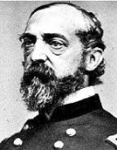
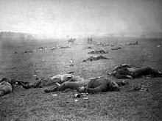
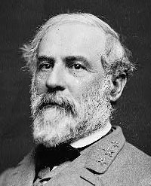
Battle of Gettysburg – July 1-3, 1863
http://en.wikiquote.org/wiki/George_Meade
http://blogs.loc.gov/civil-war-voices/about/robert-e-lee/
Gen. George
Meade - Union
Gen. Robert E. Lee
Confederate
http://en.wikipedia.org/wiki/Gettysburg_Address
The bloodiest battle of the Civil War where almost 50,000 men died. It was the turning point of the war because the North declared victory, and the South realized they could not win. The Civil War was the first war to be photographed using wet-plate process in which an image is captured on chemically coated pieces of plate glass

Slide 23
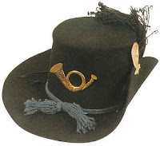
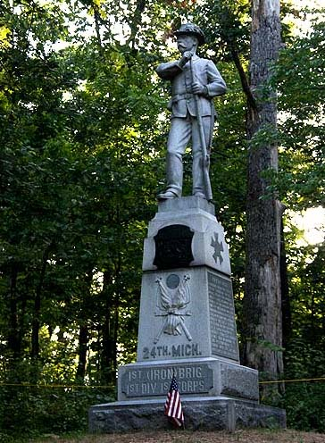
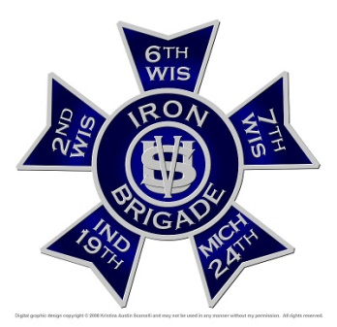
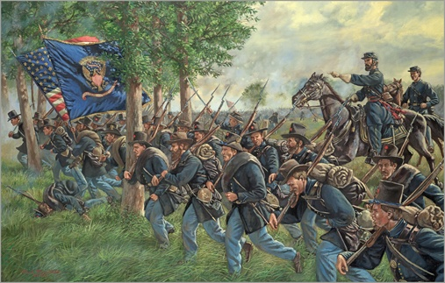
“Black Hat” Brigade (aka Iron Brigade of the West)
http://www.fsegames.eu/forum/index.php?topic=11591.0
http://en.wikipedia.org/wiki/Iron_Brigade
24th Michigan Infantry suffered 80% casualties (399 of 496 men) in the Battle of Gettysburg (higher than any of the other 400 regiments). Their sacrifice allowed Union troops to place artillery in position to defeat General Lee.
Comprised of men from Michigan, Wisconsin, and Indiana, the Iron Brigade was also known as the Black Hats because of the black 1858 model Hardee hats issued to Army regulars, rather than the blue kepis worn in most other units.
First gained fame in a battle prior to the Second Battle of Bull Run in August 1862 when it repelled attack by Stonewall Jackson’s forces.
http://www.fsegames.eu/forum/index.php?topic=11591.0
http://www.fsegames.eu/forum/index.php?topic=11591.0

Slide 24
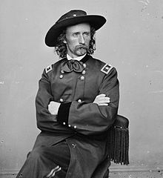
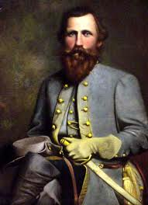
Gen. George Armstrong Custer
24 year old graduate of West Point – last in his class – commanded the Michigan Cavalry Brigade.
Born in Ohio, but he moved to Monroe which he considered his hometown, although he spent little time there.
The flamboyant “Boy General” had all his troops wear red ties. When leading a charge, he was described as a “circus rider gone mad,” who yelled, “Come on you Wolverines!”
Custer’s cavalry repelled rear attack of Gen. Jeb Stuart, assuring a victory for Gen. George Meade’s army at Gettysburg in July 1863. Stuart was later killed in Feb. 1864 by a 48 year old private from Michigan named John A. Huff, who himself died a month later.
http://friendslittlebighorn.com/custerslaststand.htm
J.E.B. Stuart
http://explorepahistory.com/hmarker.php?markerId=1-A-1EB

Slide 25
The Gettysburg Address (11/19/1863)
“Four score and seven years ago our fathers brought forth on this continent a new nation, conceived in liberty, and dedicated to the proposition that all men are created equal. Now we are engaged in a great civil war, testing whether that nation, or any nation, so conceived and so dedicated, can long endure. We are met on a great battle-field of that war. We have come to dedicate a portion of that field, as a final resting place for those who here gave their lives that that nation might live… The world will little note, nor long remember what we say here, but it can never forget what they did here. It is for us the living, rather, to be dedicated here to the unfinished work which they who fought here have thus far so nobly advanced… we here highly resolve that these dead shall not have died in vain—that this nation, under God, shall have a new birth of freedom—and that government of the people, by the people, for the people, shall not perish from the earth.”

Slide 26
BELLE ISLE
1879 – Detroit buys Belle Isle from the Campau family for $200,000 for a public park
1881 – Detroit Park Commissioner James McMillan hires Frederick Law Olmsted to redesign Belle Isle
1889 – Bridge built

Slide 27
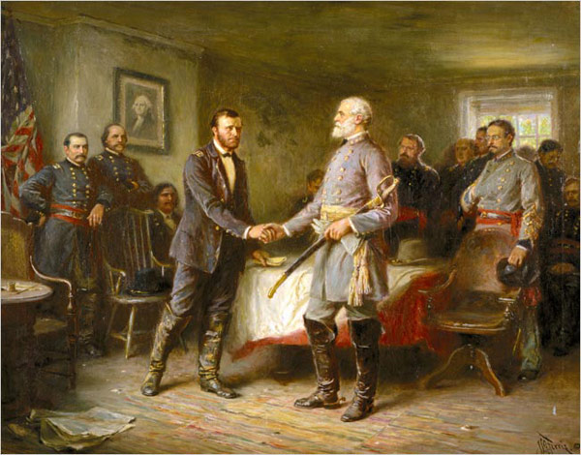
The End of the War
Michigan troops were the first to enter Petersburg, VA, forcing the evacuation of Richmond on April 3, so General Robert E. Lee surrendered to General Ulysses S. Grant at Appomattox on April 9.
Grant generously allowed Confederate officers to go home (and keep their sidearms) to avoid prosecution for treason and war crimes. Used Union ships to transport Confederate soldiers back home.
http://faculty.ucc.edu/english-chewning/catton.htm

Slide 28
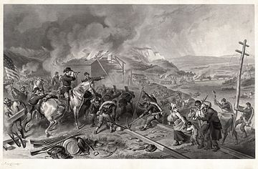
Sherman’s march to the sea - 1864
After a series of Union victories, Maj. Gen. William Tecumseh Sherman lead Union forces from Atlanta to Savannah, destroying and burning military and industrial equipment, railroads, and civilian property in an effort to demoralize the South.
http://en.wikipedia.org/wiki/Sherman's_March_to_the_Sea

Slide 29
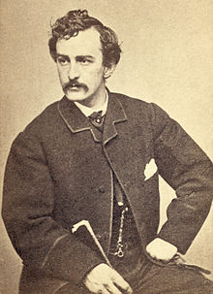
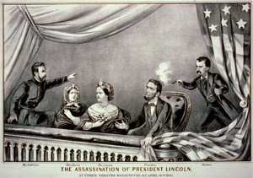
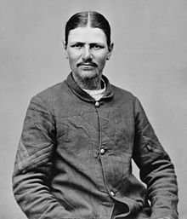
April 14, 1865
Lincoln was assassinated at Ford’s Theater in Washington DC by a gunshot to the head by famous actor John Wilkes Booth, a southern sympathizer.
At the same time, one of Booth’s accomplices stabbed Sec. of State William Seward, and another failed to assassinate VP Andrew Johnson and Gen. Grant
http://en.wikipedia.org/wiki/Assassination_of_Abraham_Lincoln
12 days later, Booth was shot and killed by Union soldier Boston Corbett, who collected a $1,600 reward. The other conspirators were hanged.
http://en.wikipedia.org/wiki/Boston_Corbett
http://en.wikipedia.org/wiki/Assassination_of_Abraham_Lincoln

Slide 30
Immigrants come to Michigan
Homestead Act of 1862 – 160 acres to every head of household.
Contract Labor Law of 1864 – immigrant could be brought in if someone paid for their passage
Copper and iron industries did well during the Civil War, but lumber did not.
Manufacturing accelerated in Detroit (Michigan Car Company started in 1864)

Slide 31
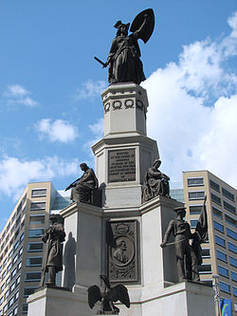
Aftermath of the Civil War
http://www.findagrave.com/cgi-bin/fg.cgi?page=gr&GRid=6248000
Gov. Austin Blair remembered as great governor
Soldiers’ and Sailors’ Monument in Detroit was built in 1872 for $75,000. Dedication was attended by Union Generals Custer, Sheridan, and Burnside.
1878 – Grand Army of the Republic (GAR) founded, which fought for pensions for veterans
Last Michigan survivor died in 1948 at the age of 107.
http://en.wikipedia.org/wiki/Michigan_Soldiers'_and_Sailors'_Monument

Slide 32
Michigan’s Contribution
Fought in >800 battles or skirmishes
69 soldiers won Medal of Honor

Slide 33
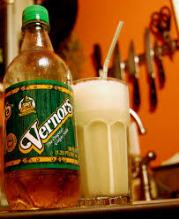
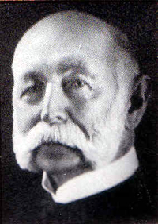

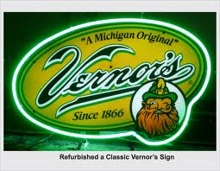
Made in Detroit
Vernor’s Ginger Ale was the first soft drink made in the United States in 1866. James Vernor, a Detroit pharmacist, served in the Civil War for four years, and left a drink stored in an oak barrel where it acquired a gingery taste. Vernor called it “Deliciously different” which is the company’s motto. He opened a drug store and soda fountain.
The Vernor family sold out in 1966. The bottling plant on
Woodward (now a WSU parking deck) was closed in 1985. It is now owned by the Dr. Pepper Snapple Group.
http://drinks.seriouseats.com/2011/11/soda-the-dubious-history-and-great-flavor-of-vernors-ginger-ale.html
A “Boston Cooler” is like a root beer float, but with Vernor’s. It’s named for Boston Street in Detroit.
http://www.gono.com/museum2003/museum%20collect%20info/earlydaysofsoda/earlydaysofsodapop.htm
http://www.undergrounddetroit.com/2010/03/the-boston-cooler-a-detroit-original/
http://cavemengo.blogspot.com/2011/10/lost-in-translation-vernors.html

Slide 34
Detroit FIRSTs
1863 – Harper Hospital created as a military hospital
1864 – First labor union forms, the Detroit Trades Assembly, by Richard Trevelick, who later organized the Knights of Labor with Terence Powderly.
1865 – Detroit Public Library opens
1868 – Detroit Medical College opens (later called Wayne State University)
1869 – First blacks admitted to public schools
1870 – U of M accepts women
1871 – First woman allowed to vote

Slide 35
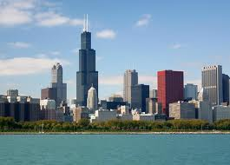
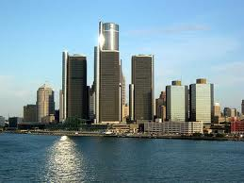
Chicago vs. Detroit
http://www.cresa.com/chicago
http://en.wikipedia.org/wiki/Metro_Detroit
1850-1880 Chicago: pop. 30,000 to 500,000
Railroads, mail order sales, meatpacking, farm equipment, iron and steel production, railway cars, clothing, grain
1850 – 1880 Detroit: pop. 21,000 to 116,000
(Didn’t reach 500,000 until after 1910)
Extractive Industries: fur trade, fishing, mining, farming, lumbering
Detroit had only 1,363 industrial jobs in 1863, but had 16,100 in 1880

Slide 36
The Rise of Manufacturing in Detroit
Year Employees Firms Value of Product
1850 9,344 2,033 $11 million
1870 64,000 9,455 $118 million
1900 162,355* 16,807 $357 million
*25% of all Michigan workers

Slide 37
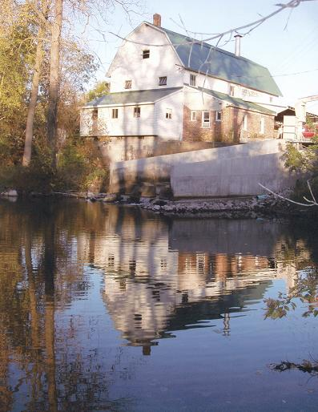
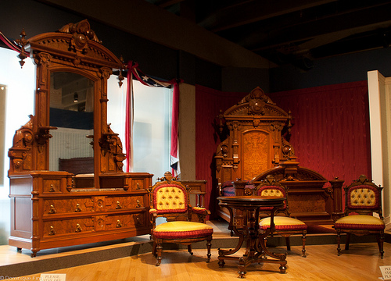
Early Manufacturing
Lumber made from wood in sawmills
Food processing (flour mills, creameries, cheese factories, sugar beet factories)
Food preserving (dried fruits)
Furniture/Cabinets from wood
The Argentine Mill in Linden was built in 1836, and is now an organic flour mill for the Westwind Milling Company.
Grand Rapids furniture @ 1876

Slide 38
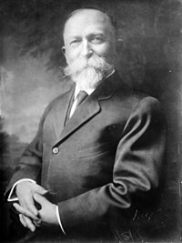
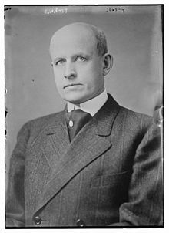
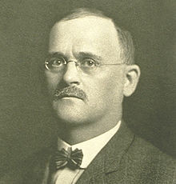
Battle Creek = Cereal City
http://en.wikipedia.org/wiki/John_Harvey_Kellogg
Dr. John Harvey Kellogg tried to create a vegetarian food at the Western Reform Health Institute, a sanitarium founded by Seventh-day Adventists. He invented a cold cereal (later called Corn Flakes), but was opposed to selling it to the public.
Charles W. Post, a patient at the sanitarium, tried to sell his version of Dr. Kellogg’s cereals, creating Grape-Nuts and “Postum,” a caffeine-free, coffee-substitute beverage. By 1900, Post was a wealthy man. He committed suicide in 1914.
http://en.wikipedia.org/wiki/C._W._Post
Will Keith Kellogg started the Battle Creek Toasted Corn Flakes Company in 1906, selling Kellogg’s Corn Flakes. C.W. Post tried to sell his imitation, called Post Toasties, but W.K. Kellogg’s company soon came to monopolize the cold cereal market.
http://en.wikipedia.org/wiki/Will_Keith_Kellogg

Slide 39
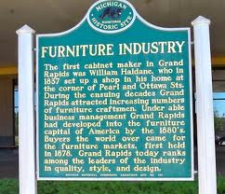
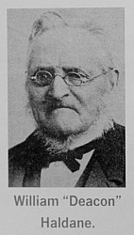
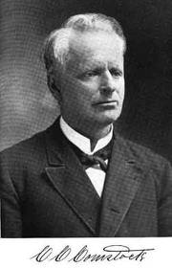
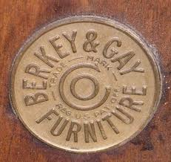
Grand Rapids = Furniture City
Born in 1807, William Haldane moved from New York to Grand Rapids in 1836, founding one of the first cabinet shops. He closed the shop 23 years later.
Haldane reportedly led his workers in prayer and Bible reading every morning before they began their work, so they called him “Deacon”.
William Powers, another cabinetmaker, founded the Powers and Ball Company in 1851
Charles C. Comstock, mayor from 1863-64 founded the first wholesale furniture manufacturing company in 1852, establishing Grand Rapids as a furniture center.
Berkey & Gay became the largest and most famous furniture maker in Grand Rapids in the 1880s.

Slide 40


Flint = Wagons and carriages
http://en.wikipedia.org/wiki/William_C._Durant
William C. (Billy) Durant was the grandson of former governor, Henry Crapo
1885 – Coldwater Road Cart Company
1886 – Started the Flint Road Cart Company with Josiah Dort
1895 – Durant-Dort Carriage Company makes horse-drawn vehicles. Dort made the carriages that Durant sold. By 1900, Durant-Dort was the #1 manufacturer in the U.S.
1898 - 125 carriage companies in Michigan, employing 7,000 workers
1908 – Durant creates General Motors
http://en.wikipedia.org/wiki/Durant-Dort_Carriage_Company_Office
Dort
http://www.businesshistory.com/ind._autos.php

Slide 41

Kalamazoo =
“The Paper City”
http://www.allposters.com/-sp/Paper-Mills-Kalamazoo-Michigan-Posters_i8669304_.htm
1867 – Kalamazoo Paper Company started by Benjamin Lyon. Samuel Gibson led company until his death in 1899.
Kalamazoo became a leading paper producer due to:
Proximity to the Kalamazoo River, which provided water to make paper and wash away waste from the paper mill
Immigrants provided labor
Proximity to Chicago to sell the paper.
Almost all paper companies gone today in Kalamazoo

Slide 42



Chemicals – Detroit, Midland
http://www.ppg.com/location/china/en/ourcompany/pages/history.aspx
Michigan’s salt deposits were used to make soda ash used to make glass, soap, and paints. Captain John B. Ford started the Michigan Alkali Company in 1894 (at age 83), later called the Wyandotte Chemicals Corporation in 1943.
Solvay Process Company started in 1895 creating soda ash.
Dow Chemical in Midland created in 1897 under Herbert Dow. Extracted useful chemicals from salt like bromine, calcium chloride (reduce dust on roads), and magnesium
Ford founded PPG Industries (Pittsburgh Plate Glass) in 1883.
Dow invented a process to create bromine, which was used in medicine and photography
http://www.findagrave.com/cgi-bin/fg.cgi?page=gr&GRid=298

Slide 43

Cement
Limestone slowly replaced marl to make Portland cement
1903 – Wyandotte Portland Cement Company founded with help of the Michigan Alkali Company and John B. Ford (“Salt Fords”), grandson of the founder, Capt. Ford.
1907 – Huron Portland Cement Company started in Alpena, closer to the limestone quarries. It eventually became the world’s largest cement facility.
1960’s – Michigan was the 4th leading state in cement
The 175-foot silos of Medusa Cement plant dominated the skyline of the Rivertown district in Detroit until 2007.
http://www.internationalmetropolis.com/2007/01/02/2006-the-year-in-review/

Slide 44


Pharmaceuticals
Dow Chemical in Midland made aspirin
Frederick Stearns open drugstore in Detroit in 1855, made the drugs he sold, and became very wealthy. Donated oriental art to the DIA, and owned Detroit’s baseball team in 1885.
The Frederick Stearns & Company building, built in 1899, and shown here in 1915, was converted in 1989 into the Lofts at Rivertown
http://en.wikipedia.org/wiki/Frederick_Stearns_Building
http://en.wikipedia.org/wiki/Frederick_Stearns_Building

Slide 45


Pharmaceuticals
Parke, Davis founded in Detroit in 1866 by Dr. Samuel Duffield and businessmen Hervey C. Parke and George Davis. By the 1890s, it was the largest pharmaceutical company in the world.
Upjohn Company founded in Kalamazoo by Dr. William Upjohn, who developed a coating for pills that could dissolve in the stomach.
Employed more women than any other Detroit industry in the late 1800’s.
http://strohriverplace.com/
Parke-Davis is now a subsidiary of Pfizer
The Parke-Davis plant and buildings were converted in the 1970s into a mixed-use development called the Stroh River Place. It’s now the Roberts Riverwalk Hotel.
http://detroit1701.org/Parke%20Davis.html

Slide 46


SEEDS
Dexter M. Ferry moved from New York to Detroit in 1852.
Bought into seed business in 1856 with Gardner & Company, then took complete control of company in 1867.
Bought out James McMillan’s Detroit Seed Company in 1879, and incorporated D.M. Ferry & Co.,with Ferry as president and James McMillan was vice-president.
Largest seed company in the world at one time. Merged in 1930 to the Ferry-Morse Company, and it is now part of Jiffy International.
http://en.wikipedia.org/wiki/Dexter_M._Ferry
http://www.icollector.com/D-M-Ferry-Co-Celebrated-Seeds-Embossed-Tin-Sign_i15045472

Slide 47


Tobacco Products
http://www.michigan.gov/dnr/0,4570,7-153-54463_18670_18793-52956--,00.html
Isaac Miller started make chewing tobacco in Detroit in the 1840s, and by 1880, tobacco products were Detroit’s most valuable “export.”
John J. Bagley made a fortune selling Mayflower brand, and Daniel Scotten sold Hiawatha brand
40 million cigars produced annually at peak in 1880s. Detroit was known as the “Tampa of the North.”
Largest industry in Detroit until overtaken by the railroad car industry.
Employed many immigrant women, particularly German and Polish
Bagley was an apprentice to Isaac Miller in 1847, and bought Miller out in 1854. He was governor from 1873-1877
http://www.esnarf.com/3449fk.htm

Slide 48


Brewing
Detroit’s oldest manufacturing activity started in 1830s with the Davis & Moore Brewery.
German immigration increased the number of breweries to over 40 in 1861, half of which were German.
Bernhard Stroh of Germany came to Detroit in 1850, and founded brewery in his basement, and sold door-to-door in a wheelbarrow. Stroh’s unsuccessful “Lion’s Head Brewery” left him deeply in debt when he died in 1882. The lion emblem is still on Stroh’s bottles today.
Sons, Bernhard and Julius, took over in 1885
1880s – 110 breweries in Detroit
Stroh’s sold ice cream during Prohibition
Stroh’s stopped brewing in Detroit in 1985, and was bought by Pabst in 2000.
The Stroh’s factory in 1864 next to the Stroh home.
http://en.wikipedia.org/wiki/Stroh_Brewery_Company
http://records.ancestry.com/Bernhard_August_Stroh_records.ashx?pid=4042733

Slide 49


Ship Building
http://civilwartalk.com/threads/the-first-iron-warship-of-the-us-navy-the-uss-michigan.90659/
1819 – Sam Ward comes to Marine City to begin building ships
1833 - Oliver Newberry builds the U.S.S. Michigan.
1852 - Detroit Dry Dock Company starts (175 steamships built in Detroit from 1827-1887)
Detroit/Wyandotte area launched more ships than anywhere else in the U.S.
1867 – James McMillan invests in Detroit Dry Dock Company, which eventually builds ships for his Detroit & Cleveland Navigation Company. For two years in 1880-82, young Henry Ford worked on engines at the DDDC.
Bay City and Marine City were important too
Ward, and his nephew, Eber Brock Ward, later became captains
The City of Detroit III was the D & C’s most luxurious ship
http://www.city-data.com/forum/detroit/1684491-detroit-we-never-knew.html

Slide 50

Detroit & Cleveland Navigation Co.
1850 – Detroit & Cleveland Steamboat Company started by Capt. Arthur Edwards with two small boats
1868 – Incorporated by John Owen as the D & C Steam Navigation Company
1877 – James McMillan invests in company and eventually owns in 1880. Built the largest side-wheel passenger steamers in the world
Went out of business in 1950
Most famous ship was the City of Detroit III. The “Gothic Room” was rebuilt in the Dossin Great Lakes Museum.
http://detroithistorical.org/dossin-great-lakes-museum/exhibitions/signature-exhibitions/gothic-room

Slide 51


The Detroit dry dock company
http://en.wikipedia.org/wiki/Dry_Dock_Complex_(Detroit,_Michigan)
1852- Campbell, Wolverton and Company
1860 – Campbell & Owen Company builds 260’ dry dock at Atwater & Orleans streets
1867 – First ship built.
1877 – Becomes DDDC after purchasing Frank Kirby’s Wyandotte
1880-1882 – Henry Ford works on first engines at the Dry Dock Engine Works (DDEW)
1892 – James McMillan becomes president of both DDDC and DDEW
1899 – Detroit Shipbuilding Company formed from DDDC, DDEW, the Detroit Sheet Metal and Brass Works, creating the 4th largest employer in Detroit.
1920s – Shipbuilding in Wyandotte and Detroit slowed after WWI, and ended in 1929.
Six buildings of the Dry Dock complex still remain, and will be redeveloped into condos
http://en.wikipedia.org/wiki/Dry_Dock_Complex_(Detroit,_Michigan)

Slide 52


FRANK Kirby
http://historicdetroit.org/architect/frank-e-kirby/
1849 - 1929
Detroit’s most famous shipbuilder and naval architect
Father was Stephen Kirby, part owner of the Detroit Dry Dock in Wyandotte, which merged with McMillan-owned Detroit Dry Dock Company in 1882.
Built many boats for the sister company, the Detroit & Cleveland Navigation Company. These included the largest sidewheelers ever, the 518’ Greater Buffalo and the Greater Detroit in 1924. and the opulent City of Detroit III in 1912.
Built the iconic Bob-Lo boats: the Ste. Claire and the Columbia
http://historicdetroit.org/postcards/boblo-island/4162/

Slide 53

Steel AND IRON
Eber Brock Ward founded the Eureka Iron and Steel Company in Wyandotte in 1853
1864 – First steel commercially produced in America using the Bessemer process.
1865 – Ward wanted to expand the factory, but Detroit investors refused, so he moved the operation to Chicago, which eventually became the world’s largest manufacturer of steel rails.
The Wyandotte factory, designed more for iron than steel, shut down in the 1892, not long after a huge boiler explosion in 1888.
Detroit was still an important center of iron manufacturing (Fulton Iron Works,
Ward was estimated to be the wealthiest man in Michigan when he died in 1875 ($10-$30 million)
http://en.wikipedia.org/wiki/Eber_Brock_Ward

Slide 54


Stoves
Detroit Stove Works founded by Charles DuCharme in 1861 making “Garland” stoves, and employing 1,200 workers.
Name was changed to Michigan Stove Company in 1871, and it made “Jewel” stoves until 1957.
8 stove factories in Detroit in 1900 (21 in Michigan)
Kalamazoo Stove Company
“Round Oak” heating stove became the most popular heating stove in the country.
The “Big Stove” was made in 1893 for the World’s Expo in Chicago, and it was on East Jefferson until 1965. It was displayed at the Michigan State Fair starting in 1998, but burned in a lightning strike in 2011.
Images: http://www.missfidget.com/?p=7643

Slide 55



Shoes
http://www.walljewelry.com/aqPingree.html
1866 - Hazen Pingree and Charles Smith buy boot and shoe factory, which became the largest shoe manufacturer in the West.
Pingree later became mayor of Detroit in 1891 and became governor in 1897.
http://www.cityfarmer.info/2009/11/28/mayor-hazen-pingree-and-the-potato-patch-plan-of-the-1890s/
http://eng.shoe-icons.com/museum/book.htm?id=816

Slide 56


Railroad Cars (the “Car Industry”)
http://eng.shoe-icons.com/museum/book.htm?id=816
1853 – Dr. George Russel starts the Detroit Car & Manufacturing Company, which built 25 cars for the Detroit & Pontiac Railway
1867 – Detroit Car and Manufacturing Co.
1868 – William Davis invents refrigerated car
1869 – George Pullman buys company and operates until 1893 making Pullman cars. Production then shifted to Chicago, which later became the leading maker of railroad cars.
1876 - Russel Wheel and Foundry Company founded by Walter, George, and Henry Russel
Russel
(1816-1903)
Pullman cars were mainly built in Chicago. They were luxury sleeping cars, and the motto was: “Travel and Sleep in Safety and Comfort”
http://www.historycentral.com/railroad/Pullman.html

Slide 57
Michigan car company
1864 - James McMillan and John S. Newberry start building railroad freight cars with capital of $20,000. Initially, the company made one freight car per day. Newberry secured a federal contract to build 2,000 railroad cars.
1865 - Both men formed the Detroit Car Wheel Company.
1874 – MCC becomes one of the largest railroad car builders in nation. The company had plants in St. Louis and London, Ontario.
1879 - 16 year old Henry Ford was fired after six days for doing 5 hour jobs in 30 minutes at the Michigan Car works.
1887 - With the sister corporations of the Detroit Car Wheel Company and the Detroit Pipe and Foundry Company employ 2,700 people (6% of the industrial jobs in Detroit)
1892 – Merged with rivals to become the Michigan-Peninsular Car Company

Slide 58
Michigan Peninsular Car Company
1892 – Michigan-Peninsular Car Company forms with merger of the Michigan Car Company, Detroit Car Wheel Company, Russel’s Wheel and Foundry and the Frank Hecker’s Peninsular Car Company.
Detroit becomes the nation’s leading manufacturer, employing 9,000 men making 100 freight cars per day. MPCC was the largest industrial employer in Michigan.
1899 – MPCC merges with the larger American Car and Foundry Company with 40 plants nationwide.

Slide 59

James McMillan – TransPortation tycoon
http://en.wikipedia.org/wiki/James_McMillan_(Senator)
Starting with building railroad cars in 1864, he and his brother, Hugh, built an empire owning iron mines, forges, foundries, railroads, depots, elevators, ships, docks, as well as banks, insurance companies, electric and telephone companies, and real estate.
Created or invested in over 50 companies, primarily in transportation and with friend John S. Newberry. He was president or director of many over the years, including Michigan Car Company, Detroit Dry Dock Company, Detroit & Cleveland Navigation Company, Duluth South Shore & Atlantic Railroad (first large railroad in the U.P.)
“Boss” of the Michigan Republican Party (the “McMillan Machine”) starting in 1879. Used his political influence to protect his financial interests, and promote Michigan industry.
U.S. Senator from 1889-1902. Obtained federal contracts for Detroit and Michigan.
1838-1902
McMillan was called “the greatest individual influence” in Detroit becoming an industrial city before the auto industry. The Detroit Free Press wrote: “No other one man ever contributed so much to the material development of the state…(He was) perhaps the most useful man that has ever lived in Michigan.”

Slide 60






Newberry and McMillan
All images from http://www.gphistorical.org/farmer07.html
Newberry was a maritime lawyer and the nephew of Oliver Newberry, the ship builder.
McMillan dropped out of school, but his father landed him a railroad job at age 20.
In 1875, James McMillan and John S. Newberry built Lake Terrace, the first “summer” houses in Grosse Pointe, starting a trend
McMillan Boathouse
Newberry’s yacht Truant was used to go to Detroit from Grosse Pointe.. It took less time than the 4-5 hour buggy ride on muddy roads.
Burton Historical Collection, Detroit Public Library
McMillan and Newberry donated $100,000 each to start Grace Hospital, named for McMillan’s daughter, Grace McMillan Jarvis, who died in 1888

Slide 61





Gilded Age Clubs
http://wwwcam.tripod.com/friendsandrelations/id6.html
http://commons.wikimedia.org/wiki/File:DetroitAthleticClub_1915.jpg
The Detroit Club was founded in 1882 and the building constructed in 1891 at 712 Cass Avenue. Hugh McMillan was the first president.
The Detroit Athletic Club was founded in 1887, but languished until its re-opening in 1913.
Founded in 1899, the University Club went bankrupt in 1992, and is now vacant.
The Yondotega Club was founded in 1892 by James McMillan and sons, William and James. It moved from 518 Jefferson in 1959 to build I-75.
http://detroiturbex.com/content/downtown/uclub/img/8.jpg
http://detroitfunk.com/?p=2202
James McMillan’s old house was the first in Detroit to get electric lights. It was used for the University Club from 1913 to 1931 until it was torn down, and the building above built on the same site.
http://atdetroit.net/forum/messages/76017/83687.html?1159238206

Slide 62








Gilded Age Yacht Clubs
http://en.wikipedia.org/wiki/Detroit_Yacht_Club
http://detroithistorical.org/learn/encyclopedia-of-detroit/detroit-boat-club
The Detroit Yacht Club on Belle Isle was a sailing club founded in 1868. The 93,000 sq. ft. clubhouse, the largest in the country, was built in 1922
The Detroit Boat Club, founded in 1839, is the second oldest continuous rowing club in the world, and the oldest yacht club in the U.S. The clubhouse on Belle Isle (built in 1902) closed in 2006.
The Old Club on Harsens Island was founded in 1872 as the St. Clair Fishing and Shooting Club of Detroit.
http://en.wikipedia.org/wiki/Grosse_Pointe_Yacht_Club
http://en.wikipedia.org/wiki/Bayview_Yacht_Club
The Grosse Pointe Yacht Club was founded in 1914. The steeple is 187’ high.
http://mjbflag.com/the-burgee-collection-n-z.html
The Bayview Yacht Club was founded in 1915.

Slide 63
An Expanding Transportation Network
1860 – Only 600 miles of railroad (3 lines: Michigan Central, Michigan Southern, Detroit & Pontiac)
1900 – 10,848 miles
Land grants from the federal government helped build lines in central and northern lower peninsula
Local governments sold bonds to finance construction of railroads owned by private companies
State sold $1.65 million in bonds and gave money to railroads

Slide 64




Railroad Expansion
1870
http://www.michiganrailroads.com/RRHX/Evolution/1870s/Lower1870.htm
1880
http://www.michiganrailroads.com/RRHX/Evolution/1880s/Lower1880.htm
http://www.michiganrailroads.com/RRHX/Evolution/1890s/Lower1890.htm
1890
http://www.michiganrailroads.com/RRHX/Evolution/1890s/Upper1890.htm

Slide 65
Pacific Railway Act of 1862
From 1850-1871, the railroads received more than 175 million acres of public land - an area more than one tenth of the entire United States and larger in area than Texas.
Michigan railroads received 6 sections for each mile of track laid, which encouraged development of the Northern LP and the UP. Grand Rapids and Indiana Railroad received the largest land grant to build line from Sturgis to Mackinaw City.
The land grants were not gifts, and the federal gov’t could carry goods and personnel at half price (gov’t saved 10x what the land was worth)
Many small independent companies operated, but many laid no track

Slide 66



The Grand Hotel (1887)
As the lumber industry in northern MI declined, railroads tried to increase tourism
Mackinac Island was tourist destination since the 1830s
John Jacob Astor House built in 1871
Built by the Detroit & Cleveland Navigation Company, the Michigan Central Railroad, and the Grand Rapids and Indiana Railroad
http://genealogytrails.com/mich/mackinac/oldhotels.html
http://www.labeltrader.com/store/index.php?main_page=index&cPath=1
http://commons.wikimedia.org/wiki/File:Mackinac_Island_Grand_Hotel.jpg

Slide 67



Freighters
http://en.wikipedia.org/wiki/R._J._Hackett_(steamer)
1869 - First bulk freighter (R.J. Hackett) built (211’ long, carrying 1,200 tons with 390 hp engine)
1882 – First iron-hulled freighter
1886 – First steel-hulled freighter
1906 – First 600 ft freighter
1952 – First 700 ft freighter
1958 – Edmund Fitzgerald launched (729’)
Owned by the mine companies
Cleveland-Cliffs company (now called Cliffs Natural Resources) was the largest, owning a fleet of ore carriers and mines, and built railroads and logging roads
http://en.wikipedia.org/wiki/Cliffs_Natural_Resources
1,000’ freighters cruise the Great Lakes, holding 79,000 tons. This is the longest, the MV Paul R. Tregurtha, with two 8,500 hp engines
http://en.wikipedia.org/wiki/MV_Paul_R._Tregurtha

Slide 68


19th century Detroit transportation
Horse Drawn Streetcar,
1863 - 1895
Detroit City Railway
Company
Allowed people to live farther from their work
http://voiceofdetroit.net/2011/10/27/the-great-trolley-riot-of-1891-the-first-detroit-uprising-against-privatization/
1886 – First electric streetcars in Detroit Detroit Electric Railway Company – limited to 20 miles until the 1890s
http://www.detroittransithistory.info/ThePingreeYears.html

Slide 69

The Interurban
Ann Arbor-Ypsilanti (1890) – Steam-driven cars soon changed to electricity with 600 passengers/day at $.10/ride.
Detroit–Ann Arbor (1898) –
Detroit – Jackson (1902) – 5,000 passengers
Detroit United interurban (1901) – Flint to Toledo, Port Huron to Jackson
Rapidly declined with popularity of the auto
http://www.myjdl.com/gallery/v/buildings/PA_FULL_771.jpg.html

Slide 70


Detroit’s Salt Mines
http://askville.amazon.com/salt-mines-detroit-mi/AnswerViewer.do?requestId=12940262
Salt is found in huge quantities in Michigan (could supply the world’s needs for thousands of years).
Only 2% used for table salt; most is used for ice removal, meat packing and chemicals.
Peaked in 1870s as Michigan produced >40% of all salt in U.S. (mined in Detroit from 1896 -1983)
#1 state in salt production from 1905-1958
Founded in 1906, the Detroit Salt Company still mines salt for ice melter products. Miners have created a 1,500-acre underground complex 1,100 feet below the city.
http://detroitsalt.com/

Slide 71

RETAIL IN DETROT
http://en.wikipedia.org/wiki/File:DetroitMajesticBldgMoonlightTower1890s.jpg
1855 - Buhl, DuCharme & Co. created, selling wholesale hardware. James McMillan has first job there.
1876 – C.R. Mabley opens Mabley & Co. in Detroit. The store was the tallest building (14 stories) from 1896-1909 until the Ford Building.
1881 – Joseph L. Hudson opens Hudson’s Department store
1897 – Sebastian S. Kresge opens his first “five and dime” store called Kresge’s. In 1977, the S.S. Kresge Company became K-mart Corporation

Slide 72

christian buhl – Furs TO railroads
http://en.wikipedia.org/wiki/Christian_H._Buhl
Came to Detroit with brother Frederick in 1833 selling hats, and then became the leading fur merchants (F & CH Buhl Co.)
1855 – Christian creates Buhl, DuCharme & Co. created, selling wholesale hardware. James McMillan has first job there. Eventually became Buhl, Sons & Co.
Christian was mayor of Detroit 1860-61.
1863 – Bought the Sharon Iron Works in PA
1864 – Bought the Detroit Locomotive Works (became Buhl Iron Works in 1880)
1881 – Bought the Detroit Copper and Brass Rolling Mill Company
Involved in building railroads, such as the Detroit, Hillsdale & Indiana and the Detroit, Eel River & Illinois
1885 – Organized the Peninsular Car Company, which merged with McMillan’s Michigan Car Company in 1892
1887 – President of the Detroit National Bank, successor of the Second National Bank he helped organize in 1883
1812-1894

Slide 73



FREDERICK BUHL
1806-1890
http://en.wikipedia.org/wiki/File:FrederickBuhl.jpg
Came to Detroit in 1833 selling hats, and then became the leading fur merchants (F & CH Buhl Co.)
1855 – Frederick continued in fur business as F. Buhl & Company, one of the largest fur shippers in the country
Frederick was mayor of Detroit in 1848,
1864 – Frederick’s oldest son, Gus, a lieutenant in Michigan’s Famed “Iron Brigade,” dies of wounds in a battle near Sharpsburg, MD
1887 – Walter Buhl takes over for Frederick Buhl
1925 – Buhl Building built on site of 1868 F. Buhl & Company building
http://en.wikipedia.org/wiki/Detroit_Financial_District
http://en.wikipedia.org/wiki/Buhl_Building

Slide 74

J.L. Hudson
1881 – Founded Hudson’s, a men’s clothing store on ground floor of Detroit Opera House.
Was former partner in Detroit’s first department store called Mabley’s in 1876.
1891 – Hudson’s Department Store built on Woodward. It is 2 million square feet, the 3rd largest store in the world.
1909 – Founded the Hudson Motor Car Company
http://en.wikipedia.org/wiki/Joseph_L._Hudson

Slide 75
Frederick Sanders
1875 – opens first ice cream shop on Woodward
Invents ice cream soda

Slide 76
INDUSTRIAL JOBS IN DETROIT
1860 – 1,363
1870 – 10,612
1880 – 16,100

Slide 77
Detroit “Firsts”
1836 – Public water supply
1851 – Gas lighting in streets, stores and factories, and finally in private homes in 1860s.
1865 – Police department after 1863 race riot
1869 – Detroit schools become integrated
1870 – Blacks vote for first time thanks to the 15th Amendment
1877 – First telephone exchange opens
1880 – Fire department replaces volunteers
1883 – Electric street lighting and incandescent bulbs
1885 – First residence with electric lighting (James McMillan’s house)
1886 – First electric streetcar
1892 – First asphalt street, replacing cobblestone or cedar block
1893 – MichCon Gas created
1893 – Edison Illuminating Company starts electricity to homes
1895 – Power station brings electricity for streetlights and public buildings
1903 – Detroit Edison created from Edison Illuminating Company

Slide 78
BELLE ISLE
1879 – City buys for $200,000 from Campau family to use as a public park
1881 – Detroit Park Commissioner James McMillan hires Frederick Law Olmsted, designer of NY’s Central Park, to redesign
1884 – Belle Isle opens
1889 – Bridge built

Slide 79
SCHOOLS
1868 – Detroit Medical College opens. Eventually became Wayne State University
1877 – Detroit College founded. Became U-D Mercy in _____.
1894 – James McMillan Elementary School becomes first elementary school in the DPS
1895 – DPS establishes kindergartens
1896 – Central High School opens at Cass and Warren. Now WSU’s Old Main building.

Slide 80

Detroit’s first “skyscraper”
With the introduction of steel, buildings taller than three stories could be built.
At 10 stories tall, the Hammond Building was Detroit’s first skyscraper in 1889. George Hammond pioneered refrigerated railroad cars.
It was located at Fort and Griswold, and it was torn down in 1956.
http://en.wikipedia.org/wiki/Hammond_Building

Slide 81
Why did Detroit become the Motor City?
Entrepreneurs (Ford, Olds, King, Durant, etc.)
Capital (lumber, mining, shipping created wealthy citizens able to subsidize innovation)
Natural Resources (proximity to raw materials like iron, copper, and lumber, and waterways)
Location (close to major markets like Chicago)
Transportation Center (ships, railroad cars, carriages, wagons). Steam engines for ships and gasoline engines for small boats were built here, and many iron forges and foundries could produce parts.

Slide 82
The Gilded Age (1877-1900)
The term was coined by Mark Twain in The Gilded Age: A Tale of Today.
An era of serious social problems hidden by a thin layer of gold
Plutocracy – wealthy had political power, and protected their interest (James McMillan). Political corruption. “Bosses”
Workers exploited – Labor Unions weak
Immigrants exploited - discrimination
Blacks exploited – Lynchings, “redemption”, segregation, discrimination
Women exploited – disfranchised, overworked, abused
Children exploited – no protection under law

Slide 83

Zachariah Chandler
http://www.answers.com/topic/zachariah-chandler
Led the Republican Party in Michigan from 1854 to his death in 1879.
U.S. Senator from 1857 to 1875
Sec. of the Interior under Pres. Hayes 1875-1877

Slide 84
Panic of 1873
Caused by the failure of a major bank that had invested heavily in railroads, whose growth had slowed. Fall in demand for silver which hurt Western mines and reduced money supply, causing high interest rates that hurt debtors.
Greenbackers – favored using dollars to cause inflation (increase money supply) to raise crop prices
Grangers – farmers protesting low crop prices and high railroad charges organized in 1872
1874 – Democrats nearly beat Bagley for governor, and Republican majority in legislature narrowed

Slide 85


Compromise of 1877 (Corrupt Bargain)
Republican Rutherford B. Hayes defeats Democrat Samuel Tilden by one electoral vote in exchange for promise to end Reconstruction in the South (pull out federal troops)
Chandler, as chair of the Republican National Committee, played important role in securing electoral votes in the South
Tilden received 51.5% of the vote in the 1876 election.
Hayes was the only president elected who lost the popular vote.
http://en.wikipedia.org/wiki/Samuel_J._Tilden
http://en.wikipedia.org/wiki/Rutherford_B._Hayes

Slide 86
Panic of 1893
Caused by some of same factors as the Panic of 1873: collapse of railroad building (bankruptcy of Reading Railroad, Northern Pacific, Union Pacific, etc.) led to bank runs and failures. Gold and silver shortage due to new mines.
Worse than Panic of 1873. Lasted until 1897, then economy recovered until Panic of 1907.

Slide 87
What is Progressivism?
Emergence of new concepts of the purposes and functions of government
Changes in government policies and institutions
The political agitation that produced those changes
Progressives = people doing one of these three things, i.e. EXPAND THE ROLE OF GOVERNMENT (Ex. Hazen Pingree)
Stalwarts = conservatives who favored “machine” politics, and opposed civil service reform (Ex. James McMillan)

Slide 88

Hazen “Potato” Pingree
http://en.wikipedia.org/wiki/Hazen_S._Pingree
Although wealthy, Pingree, a Civil War veteran, promised to be “mayor of the whole city, without regard to class, faction, or party.”
Mayor of Detroit (1889-1896), Governor (1896-1901)
Was wealthy shoe maker in Detroit, which voted mainly for Democrats. Wealthy Republicans convinced him to run for mayor in 1888.
As mayor, angered business establishment by advocating city ownership of utilities (gas, water, electric, streetcars). People, especially Germans and Poles, liked him.
Tried to lower property taxes on homes vs. businesses
Advocated community vegetable gardens (Pingree’s Potato Patches) on vacant city lots, and work projects for the unemployed during Panic of 1893.

Slide 89
The Wisdom of Hazen Pingree
“While charity is commendable, it is far better to furnish work for willing hands.”
“Charity is the handmaid of economic oppression.”
“I believe in cheapening things so that everybody can afford to pay his own taxes.”
“It takes a lot of pluck to see your old associates pass you by without speaking and not get disheartened and want to give up the fight.”
“I believe that our wealthy citizens, many of whom have accumulated the fortunes which they now enjoy through the sweat and toil of the laboring classes, owe a duty to those who have created their wealth.”

Slide 90

James McMillan
http://www.nps.gov/history/history/online_books/ncr/designing-capital/sec1.html
Led the Republican Party during the 1880s and 1890s after death of Zachariah Chandler
Tried to block Pingree’s progressive agenda in Detroit. Supported Pingree in his run as a Republican governor in 1896 so state would vote for McKinley for president, and so Pingree would leave Detroit. He believed the conservative state senate would block his reforms.
Appointed to U.S. Senate in 1889, serving until his death in 1902.

Slide 91

The Spanish-American War (1898)
The “Splendid Little War” – John Hay, American ambassador to Great Britain
Captured Puerto Rico, Cuba, and Philippines
War lasted only 4 months: 385 died in battle, but 5,000 from disease
U.S. bought Philippines for $20 million from Spain. Puerto Rico and Guam became U.S. territories, but no statehood or citizenship promised, so America owned colonies. Cuba became independent (but became protectorate in 1902). Democrats railed against imperialism without self-government. U.S. troops suppressed Filipinos 1899-1902 . Republicans said “white man’s burden” and new markets.
http://www.pbchistoryonline.org/middle-school-lessons/019-Spanish%20American%20War/019-Spanish-American_War1.htm

Slide 92

Michigan in the Spanish-American War
Only state with two regiments fighting in Cuba
Gen. William Shafter of Galesburg commanded American forces in Cuba. Fought in Civil War and Indian Wars (nicknamed“Pecos Bill”)
Russell Alger of Grosse Pointe was McKinley’s secretary of war. He resigned due to criticism of the poor food and medical treatment that the troops received. He later became a U.S. Senator after the death of James McMillan
https://cioccahistory.pbworks.com/w/page/21233938/William%20Shafter%20(6)
Shafter was 63 and weighed 300 lbs, and was chronically sick during Cuban campaign, but he did a commendable job. Teddy Roosevelt’s “Rough Riders” stole the limelight from him.
Alger served as governor from 1885 to 1886
http://en.wikipedia.org/wiki/File:Russell_Alexander_Alger2_retouched.jpg

Slide 93
The Detroit Evening News
Founded in 1873 by James E. Scripps
Sells for 2 cents rather than 5 cents
Eventually became the Detroit News in ____

Slide 94
The rise of labor unions
1880 – Detroit Council of Trade forms. Changes name to Detroit Federation of Labor in 1906

Slide 95
Detroit women’s clubs
Started in 1873 by Frances Newberry Bagley, wife of John J. Bagley, the tobacco tycoon.
1895 – First black women’s club forms by Mary McCoy

Slide 96
Culture & arts
1876 – Detroit Opera House opens
1884 – Detroit Zoological Gardens open at Michigan and Trumbull (future site of Tiger Stadium)

Slide 97


Detroit museum of art
1888 – Detroit Museum of Art opens with James E. Scripps and William Brearley of the Detroit Evening News. Moved to current building in 1927, when it was renamed the Detroit Institute of Arts
http://www.photographium.com/detroit-museum-of-art-detroit-michigan-1880-1899
http://detroit1701.org/Detroit%20Institute%20of%20Art.html

Slide 98
Detroit tigers
Detroit Baseball Company formed in 1881, the first pro team in Detroit, and a member of the National League
Renamed the Detroit Wolverines, they win the “World Series” in 1887
Became part of the American Baseball League in 1900

Slide 99


Bob-lo
1898 – Bob-Lo amusement park opens on Bois Blanc island on Detroit River (“Bois Blanc” = “white wood”)
Frank Kirby designed the Ste. Claire and the Columbia, the “Boblo boats” in 1901
Operated until 1993
Both images: http://philipstead.blogspot.com/2010/12/boat-141-boat-to-boblo.html

